Slide 1
The Fire
8D08

Slide 2
Learning Objectives
To explain the purpose of hell
To describe hell from the Holy Quran
To establish the importance of seeking protection from hell

Slide 3
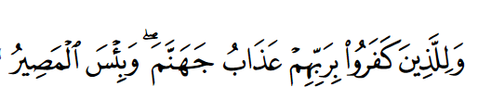
Ayah of the Day
And for those who disbelieved in their Lord is the punishment of Hell, and wretched is the destination. (67:6)

Slide 4
Keyword
تجسم : To Embody
In the hereafter our deeds will be given a shape. If we did good we will see it in a good form and if we did bad we will see it in an evil form. This is called Tajassam al amaal.

Slide 5
Allah is so kind… Why does hell exist?
When we go against the teachings of Allah we distance ourselves from heaven.
Even the smallest amount of sin cannot enter heaven because there is only goodness there!
Hell is created to purify people of their sins!!

Slide 6

Description of Hell
No pleasure, hope or relief from sorrow
The worst punishment is the feeling of being away from the mercy of Allah

Slide 7
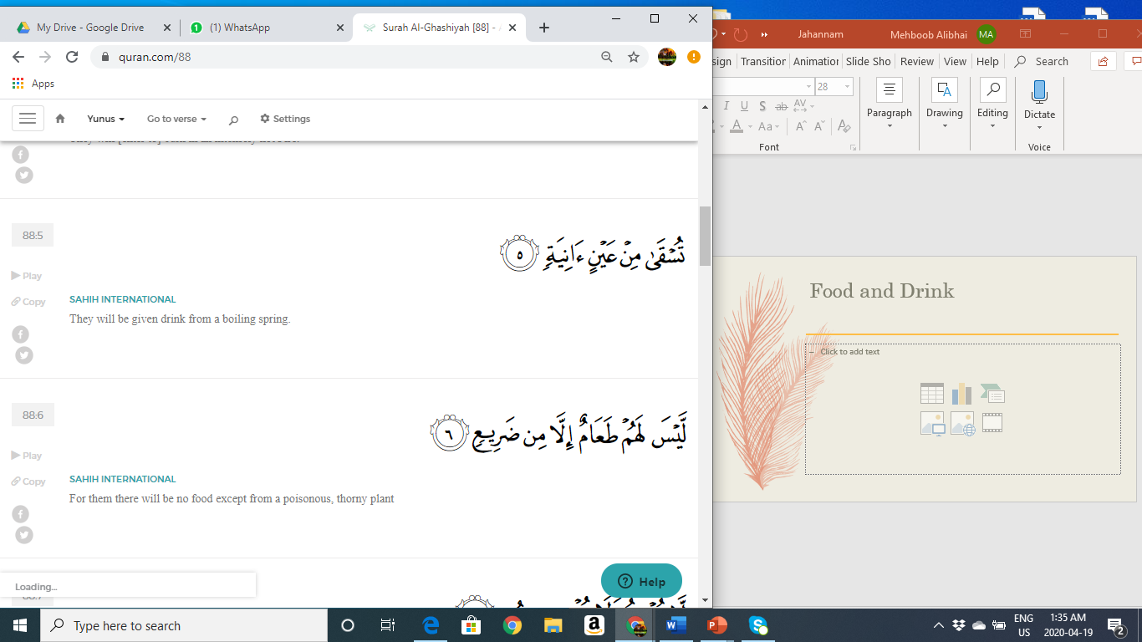
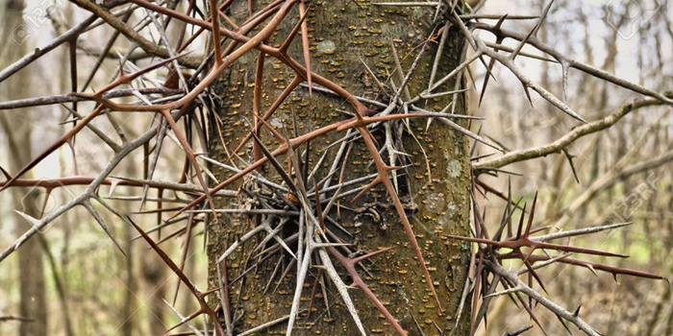
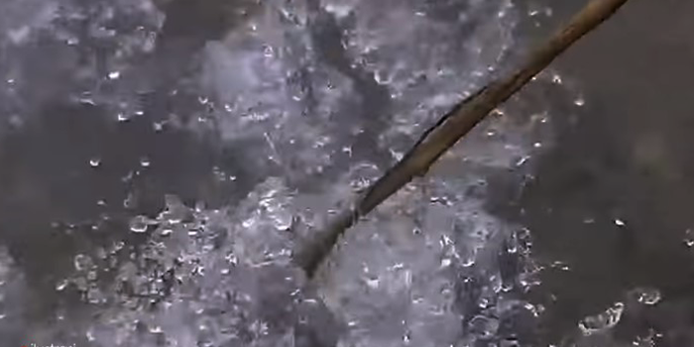
Food and Drink
They will be given drink from a boiling spring (5). For them there will be no food except a poisonous, thorny plant (6)
(88:5-6).

Slide 8
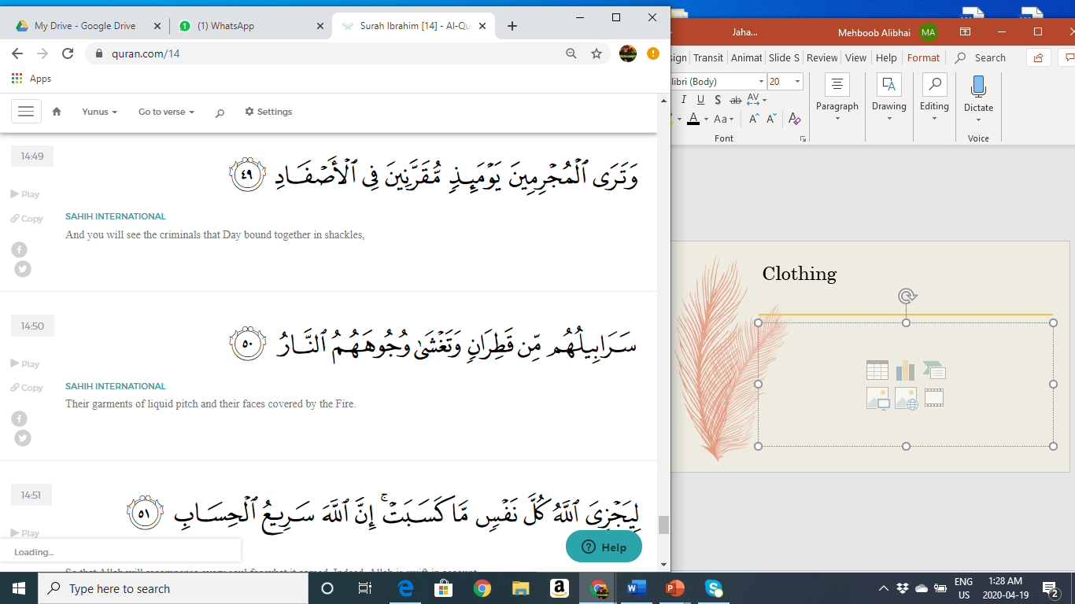
Clothing
And you will see the criminals that day bound together in shackles (49). Their garments of liquid pitch and their faces covered by the fire (50). (14:49-50)

Slide 9
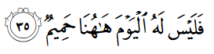
People – No devoted Friend
So there is not for him here this Day any devoted friend. (69:35)

Slide 10
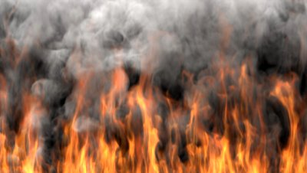
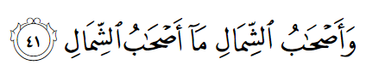
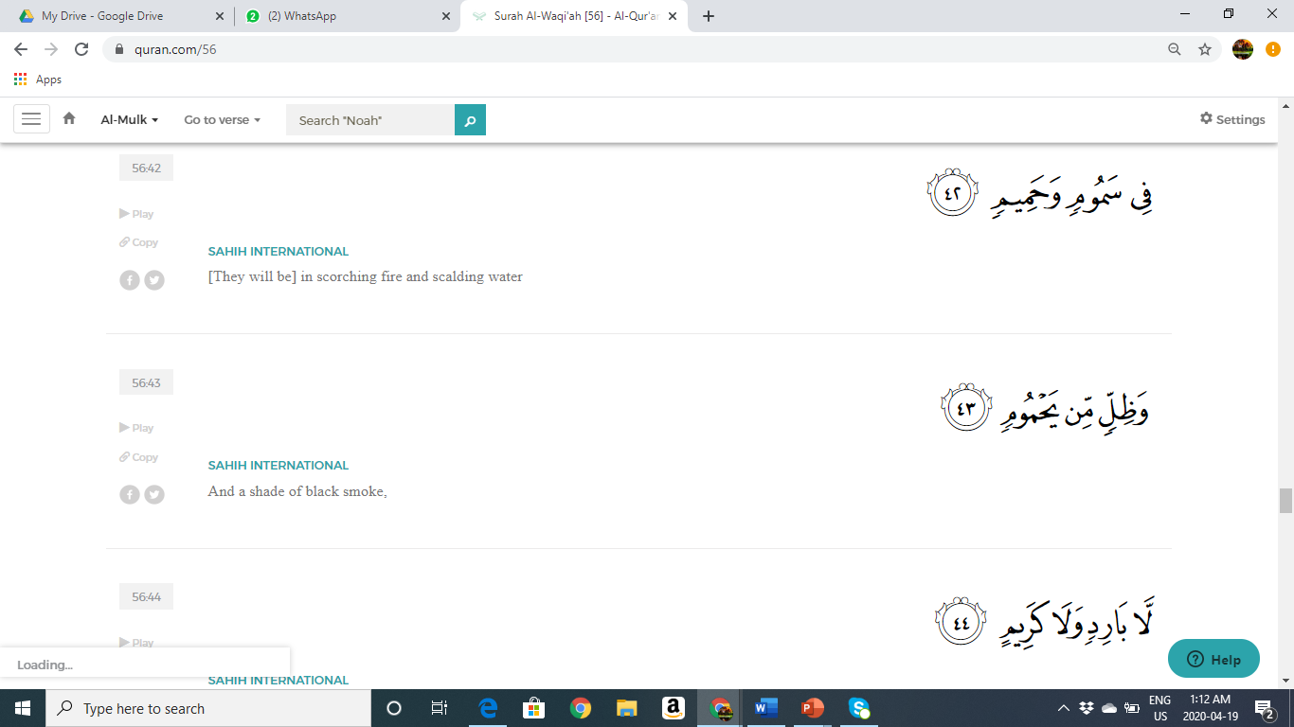
Landscape
And the companions of the left – what are the companions of the left? (41). They will be in scorching fire and scalding water (42). And a shade of clack smoke (43). Neither cool nor beneficial (44) (56:41-44)

Slide 11
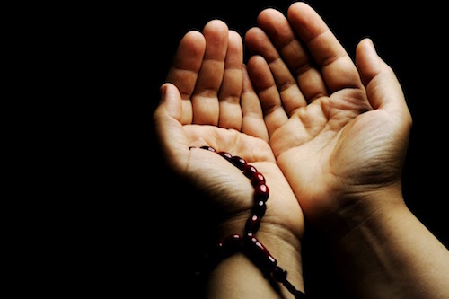
Seeking protection from the fire
In surah Furqan Allah talks about his special servants and their qualities. One of the qualities of theses special servants is that they seek protection from the fire of hell.
We seek protection from hell fire in various Ramadhan Dua’s including Dua Mujeer and Jawshan Kabeer. In this dua we repeat the following “ (I beseech you for) relief, relief protect us from the fire, O Lord!” 100 times
We also ask Allah to protect us from the fire of hell in the dua after our Maghrib Prayer.

Slide 12
