Slide 1



MODULE 7A
LESSON 01
I REMEMBER ALLAH

Slide 2

WELCOME STUDENTS
Salamun Alaykum
Boys & Girls
How are you doing?
I am so HAPPY
to see you !
Notes:
A‘udhu billahi minash shaytanir rajim
Bismillahir rahmanir rahim
Allahumma salli ala muhammadin wa ali muhammad

Slide 3
Learning Objectives
1. To recognise common Islamic phrases
2. To discover when and where these phrases are used
3. To value that these phrases are meant to keep us in constant remembrance of Allah
Notes:
Today we will learn some new words to remember Allah with….
& When to use them

Slide 4


ACTIVITY TIME
Please tell us your name
Show us the item that you are thankful to Allah for.
Lets all say: Alhamdulillah - Praise be to Allah
Notes:
Now we will play a game.
Would you like that?
You have 45 secs, go and bring something you like and want to thank Allah for it.
Please be very generous with praise!

Slide 5
Quran Ayah
الْحَمْدُ للّهِ رَبِّ الْعَالَمِينَ
All thanks is for Allah, Lord of the worlds
(Surat al-Fatihah, 1:2)
Notes:
Let us remember Allah by saying this ayat together.

Slide 6
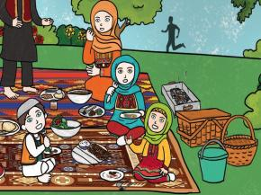
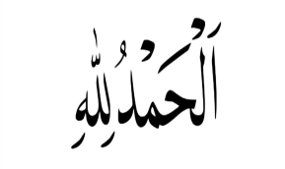
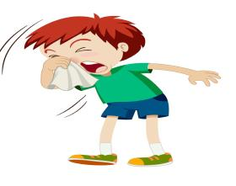
Alhamdulillah
Notes:
Does anyone know when we use this word? What do you think it means? (Alhamdulillah - Praise be to Allah)
Children at a picnic eating their food. (Alhamdulillah - Praise be to Allah)

Slide 7
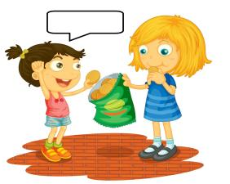
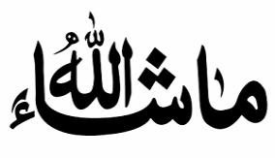
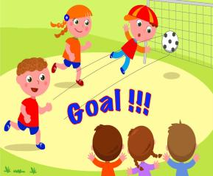
Mashallah
Notes:
Does anyone know when we use this word? What do you think it means?
(Mashallah - Allah wants it this way)
Child scoring a goal (Mashallah - Allah wants it this way)

Slide 8
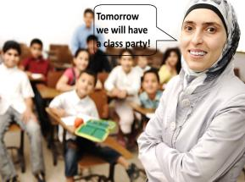
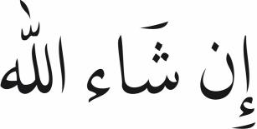
Inshallah
Notes:
Does anyone know when we use this word? What do you think it means?
(Inshallah - Allah wants it to happen)/wills
Teacher in class saying, “Tomorrow we will have a class party” (Inshallah - Allah wants it to happen)

Slide 9
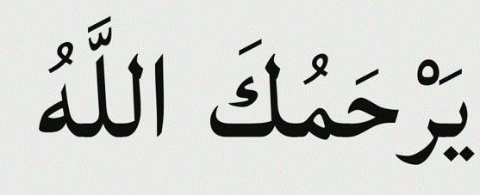
Yarhamukallah
Notes:
Does anyone know when we use this word? What do you think it means?
(Yarhamukallah - May Allah be kind to you)
When you hear someone sneezing (we say Yarhamukallah - May Allah be kind to you)

Slide 10

Jazakallah
Notes:
Does anyone know when we use this word? What do you think it means?
(Jazakallah - May Allah reward you)
Child sharing cookies with another child, speech bubble on child receiving the cookie (Jazakallah - May Allah reward you)

Slide 11
JAZAKALLAH MOM & DAD FOR:
Love me unconditionally
Food
House
Presents
Toys- Doll
Clothes
Notes:
Draw/write

Slide 12
Why it is important to use these phrases?
It has Allah’s name in it.
We say them to remind us of Allah.
Whatever happens to us we know that Allah wanted it to happen this way.

Slide 13
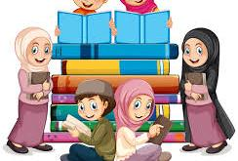
STORYTIME: AHMED AND THE COW
Notes:
Lets all get ready now for an exciting story! Are you ready to listen to one?

Slide 14
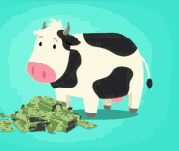

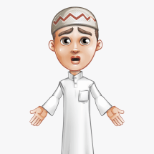

Ahmed was so happy! He had saved enough money to buy a cow of his own. Now he could have fresh milk every day. He set off to go to the market near his home to buy a cow. On the way he met his friend Burayr.
‘Salamun alaykum Ahmed!’ said Burayr.
‘Alaykum salam,’ replied Ahmed.
‘Where are you going?’ asked Burayr.
‘I am going to the market to buy a cow,’ Ahmed said happily.
‘You should say ‘Inshallah’, Burayr told him.
Notes:
Tell them to listen to the story and tell you when we should say Inshallah:

Slide 15
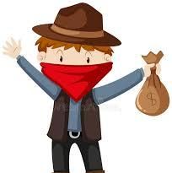
Ahmed did not think he had to say Inshallah because he had the money and he was on the way to the market. Of course he would buy the cow! He continued on his way. Just before he reached the market, a robber stopped him and took all his money away. Ahmed was very sad. He turned to go back home when he met Burayr again.
‘What happened, you look so sad. Where is the cow?’ asked Burayr.
Ahmed replied, ‘Inshallah, on the way to the market, a robber caught me, Inshallah he emptied my pockets and Inshallah he took all my money away from me.’
Burayr looked at him and smiled and explained that he was saying Inshallah at the wrong places and the wrong time. He should have said it before going to buy the cow.
Notes:
Imam Ali (a) said, “Remembering Allah makes hard things and unhappiness go away.”
Explain this hadith by Imam Ali (a) to show the beauty of remembering Allah at all times. Discuss why they think remembering Allah takes away difficulties. He is the strongest and most powerful. Who can help us better than Him?

Slide 16
Quran Ayah
الْحَمْدُ للّهِ رَبِّ الْعَالَمِينَ
All thanks is for Allah, Lord of the worlds
(Surat al-Fatihah, 1:2)
Notes:
Wasn’t that an awesome story? Let us remember Allah by saying this ayat together.

Slide 17
Arabic Vocabulary Game
Alhamdulillah - Praise be to Allah
Mashallah - Allah wants it this way
Inshallah - Allah wants it to happen
Yarhamukallah - May Allah be kind to you
Jazakallah - May Allah reward you
Notes:
Remember, each of these words has Allah’s name in it we say them as a constant reminder of Allah and whatever happens to us we know that Allah wanted it to happen this way….
Children at a picnic eating their food. (Alhamdulillah - Praise be to Allah)
Child scoring a goal (Mashallah - Allah wants it this way)
Teacher in class saying, “Tomorrow we will have a class party” (Inshallah - Allah wants it to happen)
When you hear someone sneezing (we say Yarhamukallah - May Allah be kind to you)
Child sharing cookies with another child, speech bubble on child receiving the cookie (Jazakallah - May Allah reward you)

Slide 18
Fi Amanillah - “May Allah Protect You”
Thank you for joining us today Boys & Girls
Remember to thank Allah this week
Imam Ali (a) said, “Remembering Allah makes hard things and unhappiness go away.”
Inshallah, see you next week

