Slide 1

Tarbiyah 6B03
Hajj
Notes:
Audhubillah...Bismillah….Salawaat
Salaam Alaikum!

Slide 2



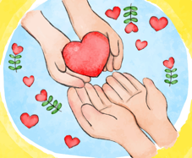





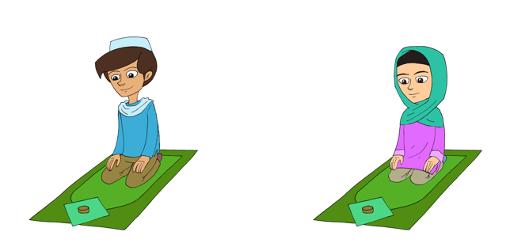

Furu ad-Din
Khums
Jihad
Amr bil Ma’ruf
Zakat
Nahi Anil Munkar
Hajj
Tawalla
Sawm
Salah
Tabarra
Notes:
In last week’s lesson, we talked about the furu ad-din. Let’s do a quick review:
(Let students name the 10 furu ad-Din)
Today, we are going to talk about the 3rd furu ad-din - who can tell me which one that is?
That’s right! It’s Hajj! (click for animation)
After Nabi Ibrahim built the Kaaba with his son Nabi Ismail, he called all the people to come for hajj. Many special people answered this call of Nabi Ibrahim to come for hajj. After him, all the ambiya and all the a’immah went for hajj. So we too follow in their very special footsteps.

Slide 3
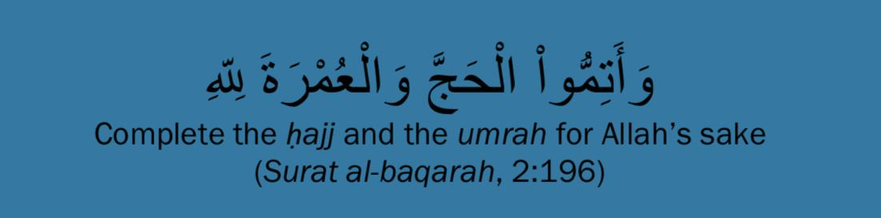
Ayah
Notes:
Allah swt says in the Holy Qur’an (read Ayah with translation)
(OPTIONAL) What are some of the steps we complete in hajj? (students can respond)
Today, we are all going to learn how to perform hajj just as we learnt it from our ambiya and Aimmah! Are you ready?

Slide 4
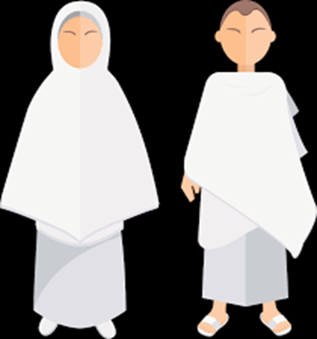
Ehram
Special clothes we wear for hajj
White in colour
Same for everyone!
“I am obedient to Allah”
Notes:
When we go for Hajj we wear special clothes called the ehram. These are white in colour. Did you know that everyone wears the same clothes? We wear the ehram to show we obey Allah and follow Him at all times.
(The students can pretend to put on their ehram (or you can ask the students to come to class wearing white clothes if they would like).
Great job! When we wear our ehram, we say “I am obedient to Allah” - Say it with me……)

Slide 5
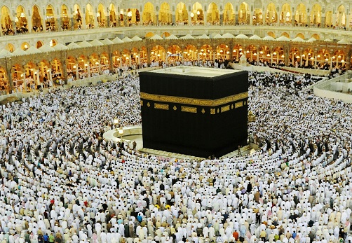
Tawaf
First step of Hajj
Going around the Ka’bah 7 times
“I come to Allah”
Notes:
This is the first step of Hajj. Do you remember the special house that Nabi Ibrahim and Nabi Ismail built – the Ka’bah? Tawaf is when we go around the Ka’bah seven times. When we do tawaf we are saying to Allah, “I am coming to you O Allah”.
(Ask the students to go around a table or chair seven times (anticlockwise) as if they are doing tawaaf). Start by saying “Allahu Akbar”.
(Once they have completed tawaf) When we do tawaf, we are saying “I come to Allah”. Say it with me….

Slide 6
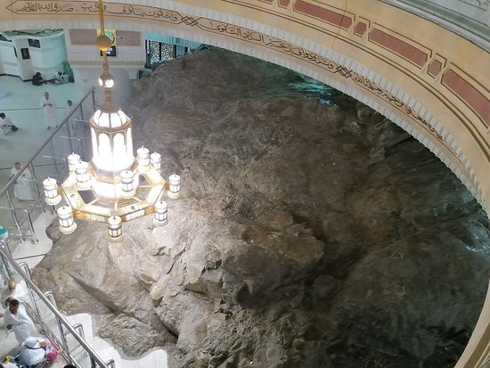
Sa’ee
Running between 2 mountains called:
  Safa
  Marwah
Like Lady Hajar looking for water for her baby, Nabi Ismail
“I run to Allah”
Notes:
Do you remember the story of Lady Hajar and her baby son, Nabi Ismail? (Briefly recap the story of Lady Hajar running looking for water).
Do you remember what these mountains are called? (Let students respond)
So now we move on towards the two mountains called Safa and Marwah. We run between these mountains just like Lady Hajar did when she was looking for water for her baby son Nabi Ismail. This is called Sa’ee. We do sa‘ee to remind ourselves we are always running to Allah with all our hopes.
(Ask the students to run to the end of the room and back to you). When we do sa’ee, we are saying “I run to Allah”. Say it with me...

Slide 7
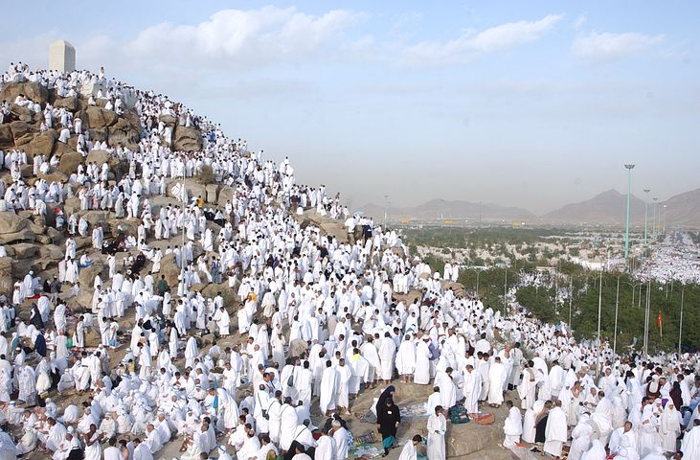
Arafah
Special land where Muslims spend the day:
  Talking to Allah
  Asking Allah for many blessings
  Asking Allah to forgive them
  Praying for their book of deeds to be filled with lots of lovely good deeds
“I show my book of deeds to Allah”
Notes:
(Ask the students to sit down)
Arafah is a special land where all Muslims who are performing the Hajj spend the day just talking to Allah. They ask for many blessings and for Allah to forgive them. They remember that on the Day of Judgement they will have a book of deeds to give to Allah and they pray for their book to be filled with lovely deeds. It’s such a special time! Let’s all close our eyes for one minute and raise our hands in du’a asking Allah to make our book of deeds all sparkly and wonderful. You can also pray for your wishes. Don’t forget to pray for others first like your family, neighbours, friends, the sick and of course our beloved Imam al- Mahdi (a).
(Let the children spend a minute in self-contemplation). In Arafah, we show our book of deeds to Allah. Let’s say it together “I show my book of deeds to Allah”.

Slide 8
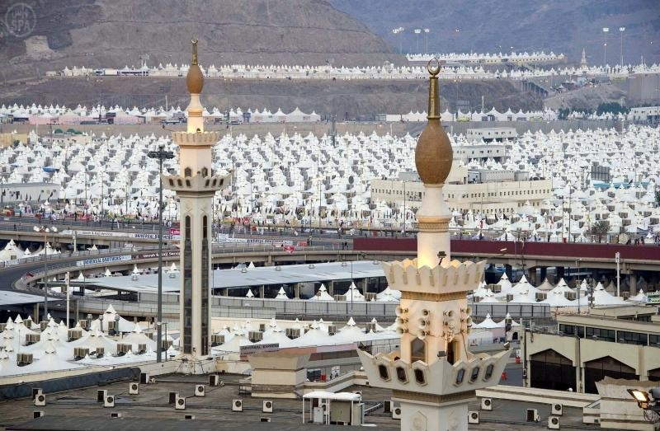
Mina
Tent city
Muslims meet and get to know each other
And learn how to live together in peace
“I am a peace-loving human”
Notes:
We then move on to the tent city of Mina – that’s what it looks like, rows and rows of tents all filled with Muslims! This is where Muslims from all over the globe get a chance to meet and get to know each other. We learn how to bond with our fellow brothers and sisters and live together in peace. We remind ourselves that all Muslims are safe with each other.
Go and greet someone in your house and find out something about them that you didn’t know (Give students 1-2 mins to do this - if there is time ask a couple of students to share who they spoke to and what they found out about them). By getting to know our Muslim brothers and sisters, we are saying “I am a peace-loving human”. Say it with me….

Slide 9

Jamarat
Throwing stones at Shaytan
Just like Nabi Ibrahim!
“I say NO to Shaytan”
Notes:
While we’re in Mina, we perform a special action following in the footsteps of Nabi Ibrahim. Let’s listen to a story:
One day, Nabi Ibrahim had a dream where he was asked to give his son, Nabi Ismail, back to Allah. He had this dream three times and knew that he should obey Allah. He told his son, Nabi Ismail about the dream who agreed that if Allah had asked for it then it should be done. Nabi Ibrahim set off and on the way, Shaytan came to him telling him not to obey Allah. Nabi Ibrahim did not want to listen to Shaytan who kept bothering him so he picked up some stones and threw them at Shaytan.
Nabi Ibrahim put on a blindfold as he was about to follow Allah’s command. When he took it off, he saw that Allah had replaced his son with a sheep to show that he had passed his test. He was ready to give his son back to Allah and that was enough. Nabi Ismail was standing right next to him smiling! Allah loved this act of obedience by Nabi Ibrahim so much, that when Muslims go for Hajj, they all follow in his footsteps by throwing stones at Shaytan and sacrificing an animal.
We throw stones at Shaytan who always tries to make us do bad things. We do this act to show that no matter what he tries against us, we will always say NO to Shaytan!
(Ask the students to pretend that they are throwing stones at Shaytan - just pretend stones, no objects!) When we’re throwing stones at Shaytan, we are saying “I say NO to Shaytan”. Say it with me...

Slide 10
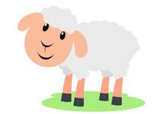
Eid Sacrifice
Sacrificing an animal just like Nabi Ibrahim did
The meat is shared between the poor and the other Muslims
Reminds us: We should always share and not be greedy
“I am a giver”
Notes:
Our stay in Mina comes to an end after sacrificing an animal just like Nabi Ibrahim did. The meat from this animal is shared between the poor and the other Muslims. We do this sacrifice to remind ourselves to always share and give from what we have and not be greedy for things in this world.
By doing this, we are saying, “I am a giver”. Say it with me….

Slide 11
Tawaf
Back to the Ka’bah for tawaf
All our sins are wiped and we are pure!
Oh Allah! We are holding on tightly to Your love and will never disobey You
“I come to Allah free of sins”
Notes:
At the end, we come back to the Ka’bah for tawaf. At this stage all our sins are wiped out and we become pure and sinless like a new born baby. We come back to the Ka’bah to tell Allah that we are holding on tightly to His love and we will never disobey Him.
(Ask the children to do go around the table or chair again 7 times anticlockwise) In this last step of Hajj we come to Allah free of sins. Say it with me “I come to Allah free of sins”.
MashaAllah, you all just completed your hajj! (Time permitting, can choose to call out each child using Haaji for boys and Haajiya for girls to congratulate them)

Slide 12
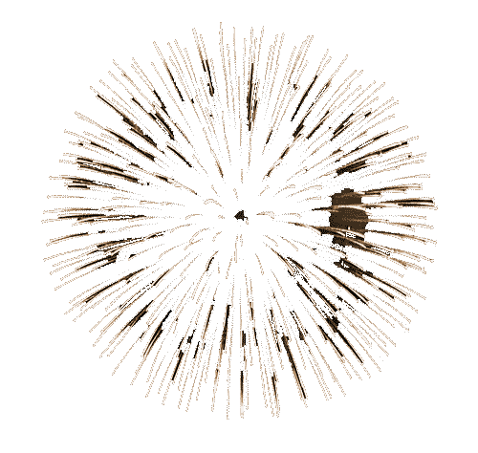

Usul ad-Din
Hajj
Tawheed
ma’ad
Adalah
Imamah
nubuwwah
Notes:
We just finished talking about Hajj, which is one of the furu ad- din, one of the branches of our religion. But how does the branch grow? (Elicit that nutrients must go from the root, up the trunk and to the branches in order for the branch to grow. See animation)
(Ask the children to name the usul ad- din as you show them on the roots.) For the branches (furu ad- din) to grow, the nutrients must come from the roots (usul ad- din). Let’s take a look at how each usul connects to and gives nutrients for Hajj:
(click to highlight each usul as you talk about it)
Tawheed: We obey ONLY Allah by answering the call for Hajj.
Adalah: We are all equal. Remember, in ehram we look exactly alike.
Nubuwwah: Answering the call of Nabi Ibrahim to go to Hajj as commanded by Allah.
Imamah: Our deen is safeguarded by our a’immah. They taught us Hajj, and the rules and the intentions behind all the actions
Ma‘ad: Remembering at all times that we have to answer to Allah and show Him our book of deeds.
That’s our lesson for today (click 3 times for fireworks).

Slide 13
Lesson Objectives
To recall that Hajj is one of the furu ad-din (branches of religion)
To demonstrate the steps of Hajj
To explain the spirit behind the prescribed steps of Hajj
To relate through the example of hajj that the furu ad-din are fuelled by the usul ad-din

