Slide 1

Tarbiyah 6B01
The Islamic Months
Notes:
Audhubillah...Bismillah...Salawaat

Slide 2

Every day is like a gift box from Allah.
We can put in it whatever we like.
What would you choose to put in your gift box to Allah?
Yes, actions that Allah loves!
Notes:
Pretend that it is your best friend’s birthday today and you want to give them a present in this gift box. Would you want to give them something that they would like? Or just anything would be fine? Something they would like right? Of course!
Each day of our lives is like a gift box from Allah (swt). He tells us that we can put whatever we want inside it - from the moment we wake up till the moment we go to sleep, we can fill the box with what we choose!
What would you choose to put into your gift box to Allah? It would be something that Allah likes right? But there’s so much He likes!
Name an action that you would put into the gift box….

Slide 3
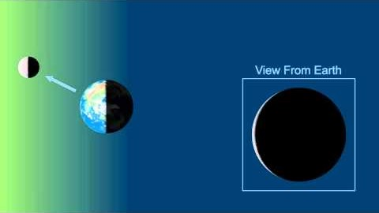
Lunar Calendar
Notes:
The Islamic calendar is based on the moon and its different phases. It is called the LUNAR calendar - lunar means to do with the moon. One month in the Islamic calendar is the time it takes for the moon to orbit or go all the way around the earth one time.
(Play video and explain phases of the moon a little (can pause video in between to explain if needed))
Have you ever looked up at the moon at night? Does it always look the same to you?
The moon looks like it changes shape from night to night but that is just the part of the moon we can see as it goes around the earth. When the moon is between the sun and the earth - we can’t really see it, a very tiny part of it is usually available for a very short time at sunset - that is known as the new moon and is the beginning of a new month in the Islamic calendar. The next new moon we see will be the start of Ramadhan!
As the days go by, we can see more and more of the moon until we see the full moon in the middle of the month - then we start seeing less and less of the moon until the end of the lunar month until we get to the new moon again and a new Islamic month!
Does anyone know how many lunar months there are in the islamic calendar? 12

Slide 4
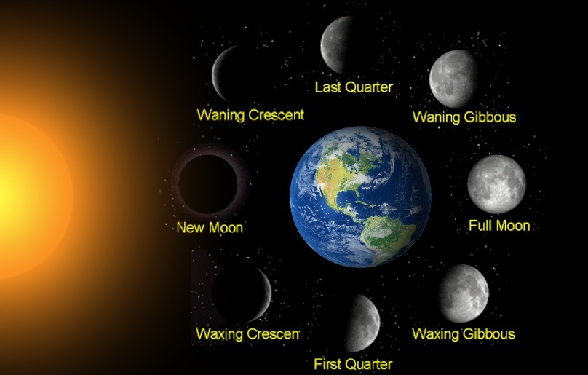
The Islamic calendar is a lunar calendar
It is based on the phases of the moon
Notes:
***Slide for google classroom

Slide 5
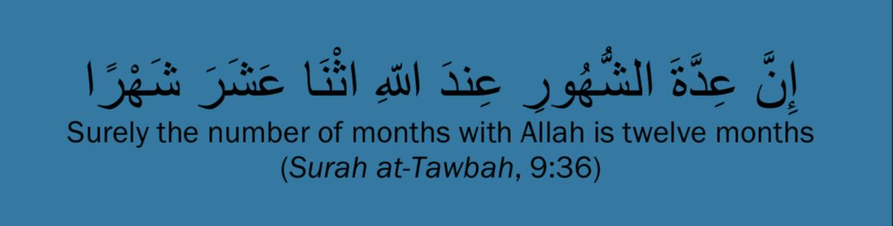
Notes:
(read ayah and translation)
Allah tells us in the Holy Qur’an that there are 12 months in the islamic/lunar calendar.

Slide 6
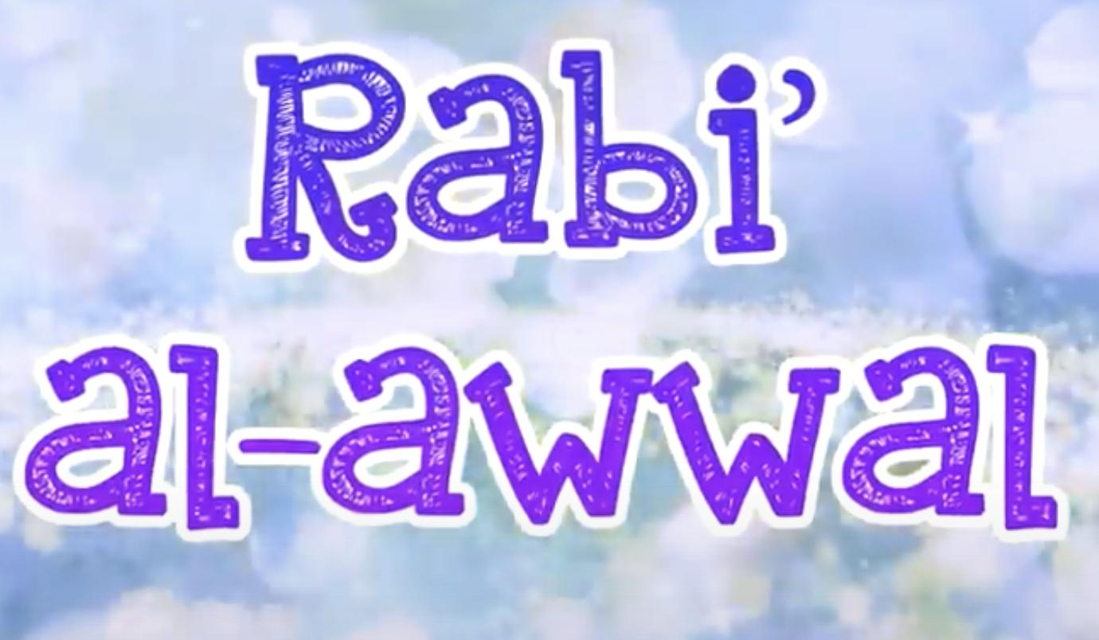












The 12 Islamic Months
Notes:
What are the names of the 12 Islamic months? (Can have students take turns naming one at a time and transition in each name as called out)
Very good! Let’s listen to the Islamic months rhyme - some of you may have heard it so feel free to sing along. (Play audio)

Slide 7
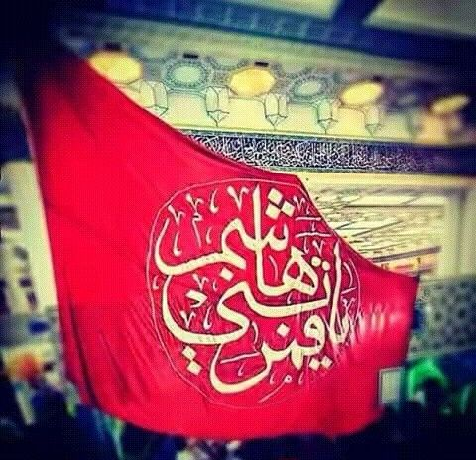
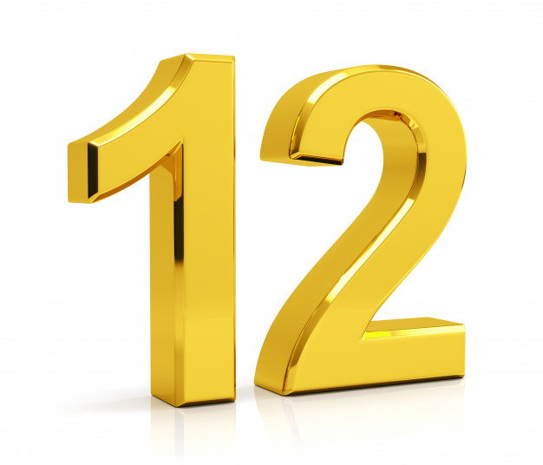
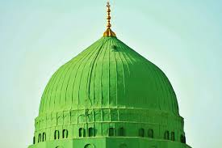
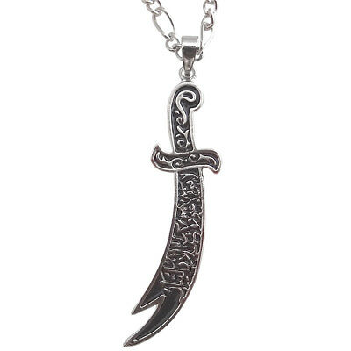


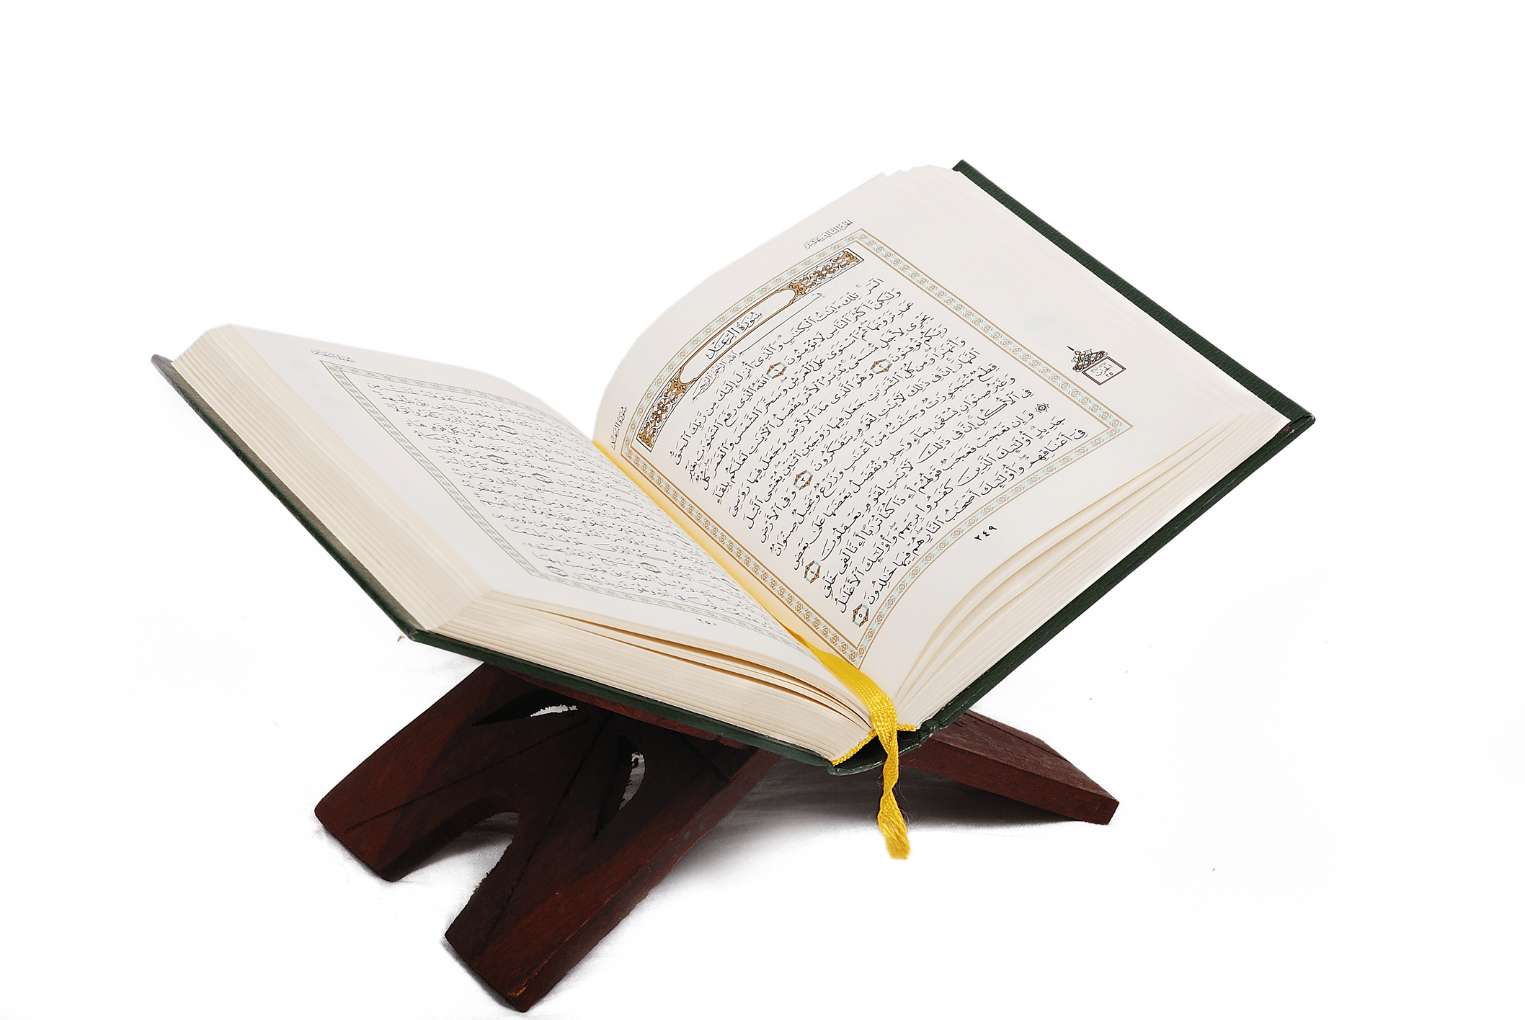
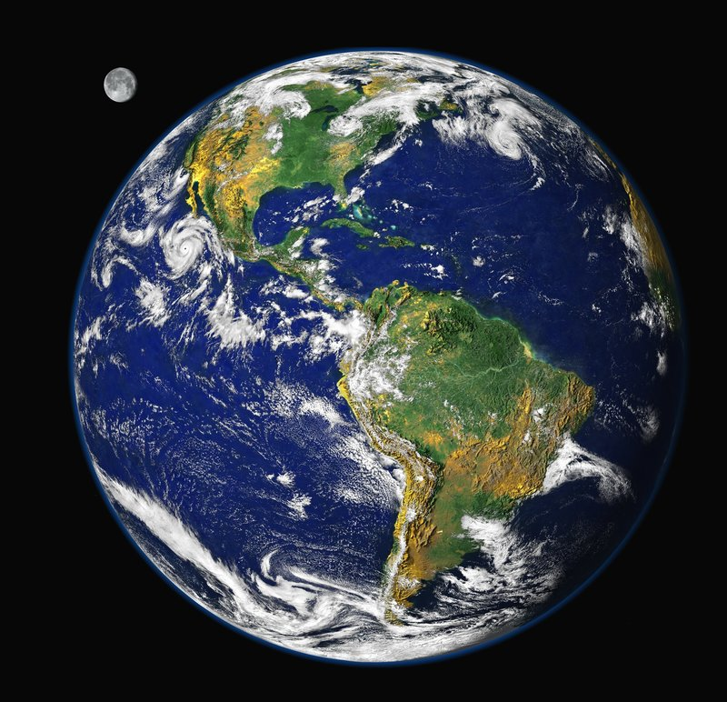
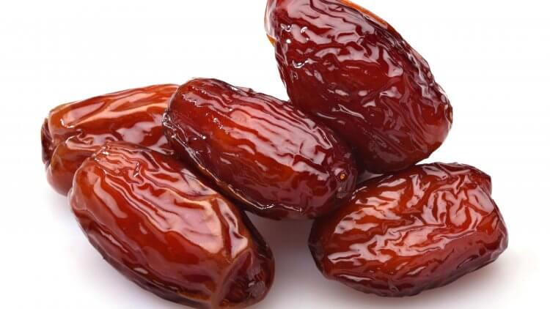
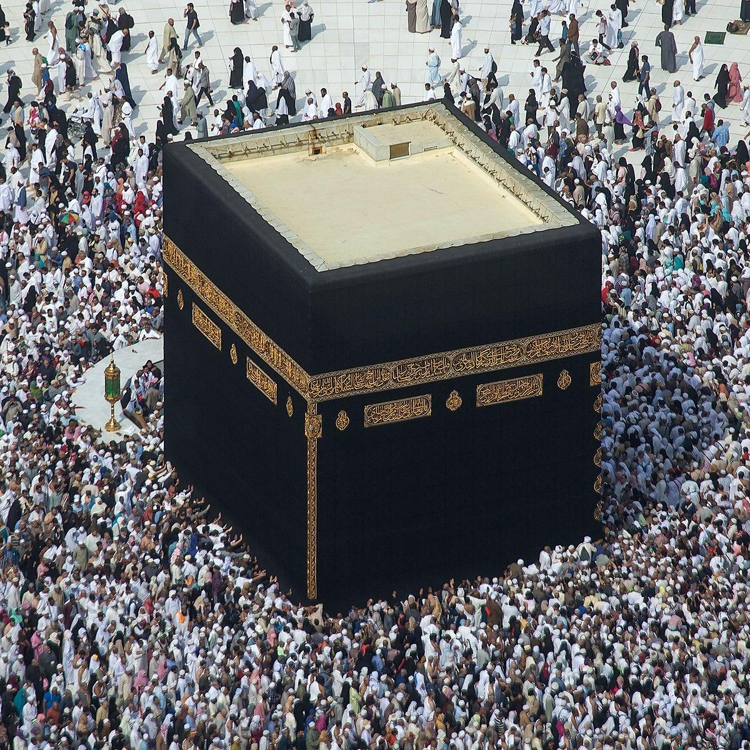
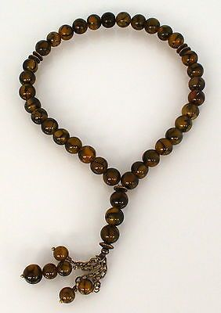
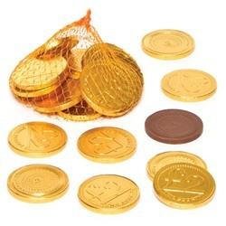

Alam | Twelve | Green Dome | Dhulfiqar
Hijab | Fourty | Quran & Dates | Earth
Kaaba | Tasbeeh | Chocolate coins | Dad
Notes:
Do you see all the objects on the screen? Each one is connected to one of the months of the Islamic calendar. Let’s work together to figure out which object belongs to which month. Some are easier to guess than others but don’t worry, I will give you clues along the way to help you out.
Remember that each Islamic month has special events that take place in it that help us to become better people (discuss a quick and simple example in each slide)
(Give students a chance to guess the month from the objects - clicking on the word below the object will take you to the corresponding slide and clicking on the title month on that slide will bring you back to this slide).

Slide 8
Muharram
The events of Karbala & the day of Ashura
Notes:
The day of Ashura occurred on the 10th of Muharram (optional to mention). How do the events of Karbala and the day of Ashura help us become better people?
E.g. of answer - It reminds us how to be brave and loyal like Imam Husayn (as) and his companions. Or..It reminds us to always say the truth and stand up for what is right.

Slide 9
Safar
Arba’een
(the 40th anniversary of the day of Ashura)
Notes:
How does arba’een help you to become a better person?
E.g. of answer - (similar to answer for muharram)

Slide 10
Rabi al-awwal
Rasulullah (saw) was born!
Notes:
How does celebrating the birth of Rasulullah (saw) help us to become a better person?
E.g. of answer….It reminds us to be patient and truthful like him because Allah loves those who are patient and truthful

Slide 11
Rabi al-aakhar
Imam Mahdi (as)’s father, Imam Hassan al-Askari (as) was born!
Notes:
How does remembering Imam Hassan al-Askari (as) help us to become better people?
E.g. It reminds us to be good and kind like him.

Slide 12
Jamadi al-awwal
Birth of Sayyidah Zainab (sa)!
Notes:
How does celebrating the birth of Sayyidah Zainab (sa) help us become a better person?
E.g. It reminds us to be strong and stand up for justice.

Slide 13
Jamadi al akhar
Sayyidah Fatema (sa) was born and died in this month.
Notes:
How does remembering Sayyidah Fatema (sa) and the tasbeeh help us to become better people?
E.g. answer - It reminds us that remembering Allah frequently helps us stay away from bad deeds.

Slide 14
Rajab
Imam Ali (as) was born!
Notes:
How does celebrating the birth of Imam Ali (as) help us to become a better person?
E.g. answer - It reminds us to be patient and control our anger like he used to.

Slide 15
Sha’baan
Imam Mahdi (as) was born!
Notes:
How does celebrating the birth of our living Imam, Imam Mahdi (as), help us to become better people?
E.g. answer - It reminds us that we should pray for everyone in the world just like he does. Don’t forget to pray for him to be safe and come quickly as well!

Slide 16
Ramadhan
The holiest month of the year!
Notes:
How does the month for Ramadhan help us to become a better person?
E.g. answer - Fasting, praying on time, reciting quran, taking out sadaqah, being kind to neighbours, and more... these are all acts we do in Ramadhan that help bring us closer to Allah and make us better people - Alhamdulillah!

Slide 17
Shawwal
1st Shawwal is Eid al-Fitr.
Eid Mubarak!
Notes:
How does celebrating Eid make us a better person?
E.g., Getting together for Eid namaaz and visiting family and friends reminds us that we should all be united and take care of each other.

Slide 18
Dhul qa’dah
Dahwul Ardh
(the expansion of the Earth)
Notes:
The day of the Earth’s expansion - 25th zilqaad - It is the day Allah spread the Earth for His creation to be able to live on it and benefit from it. MashaAllah what a beautiful gift from Allah! Being a good person means taking care of this amazing gift, the Earth and of all of Allah’s creations.

Slide 19
Dhul Hijjah
Muslims go for Hajj
Notes:
How does Hajj remind us to be a better person?
The month of Hajj reminds us that all Muslims are my brothers and sisters so loving them all and not fighting with anyone

Slide 20
Lesson Objectives
To recognise that each day is a gift box from Allah.
To discover that the Islamic calendar is based on phases of the moon.
To explain that every month brings a unique opportunity for self-purification (to become a better person).

