Slide 1
Actively Awaiting Imam Mahdi (a.s.)

Slide 2
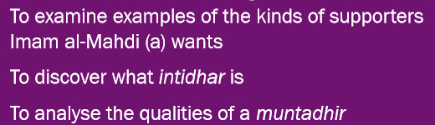
Learning objectives

Slide 3
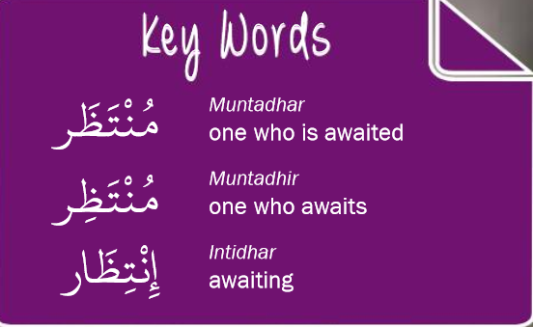
Key WORDS

Slide 4



Contrasting two types of calling
Calling the Prophet (saws) by the people of Medina.
Calling Imam Hussain (as) by the people of Kufa.

Slide 5
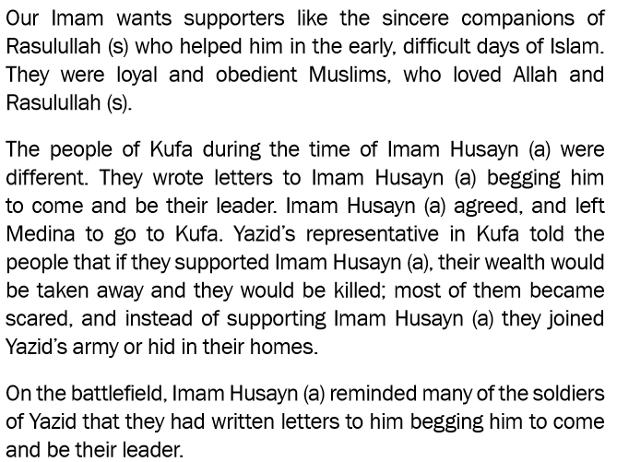
CONTINUED
FROM PREVIOUS SLIDE

Slide 6
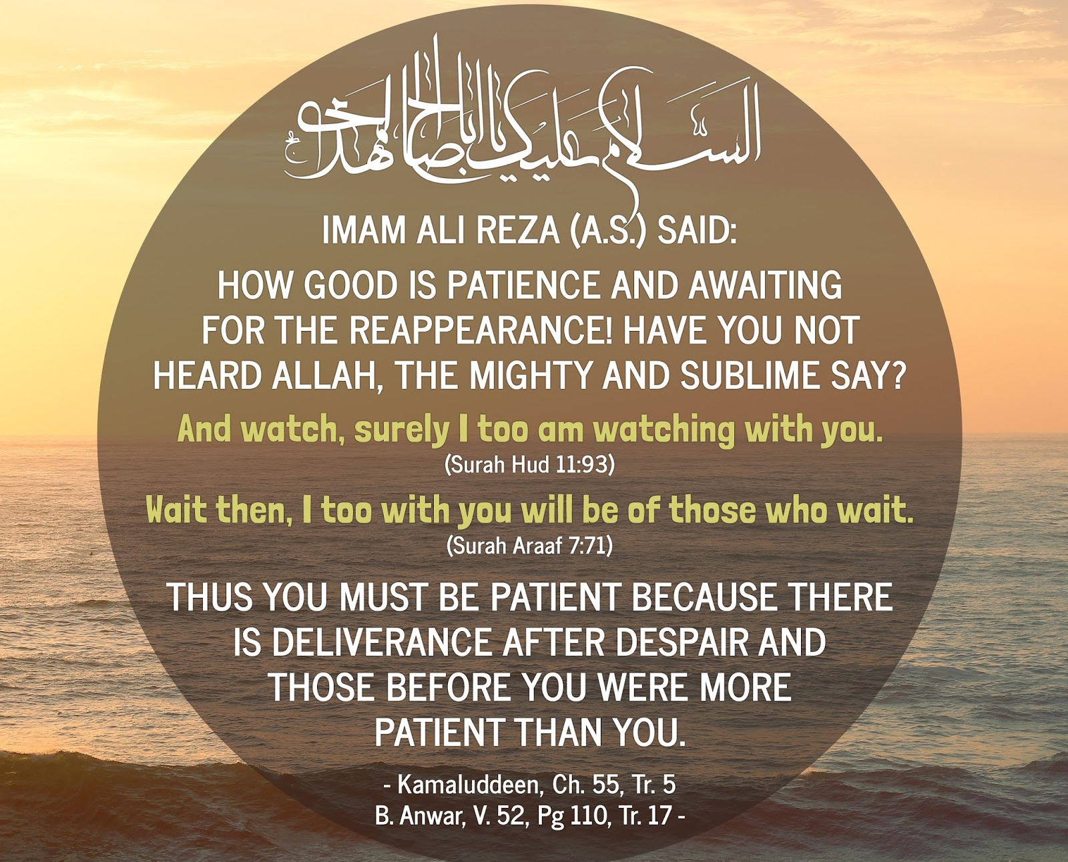
INTIDHAR
Intidhar means to wait.
We are actively waiting for Imam Mahdi.

Slide 7

What does ‘ACTIVE’ Waiting mean?
Do you remember the feeling of restlessness when you are waiting for a best friend you haven’t seen in a long time?
Or how impatient we feel waiting for Eid or our birthday, looking forward for all the gifts?
Do we miss our Imam? Are we praying to see him everyday?

Slide 8
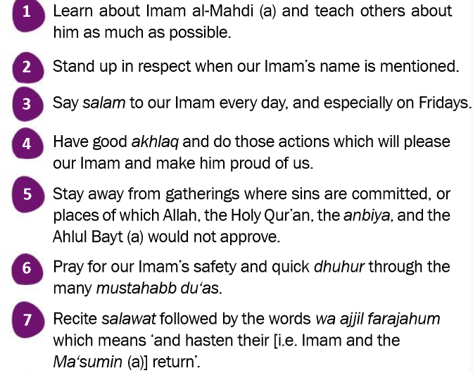
WE CAN BE A TRUE MUNTADHIR BY:

Slide 9
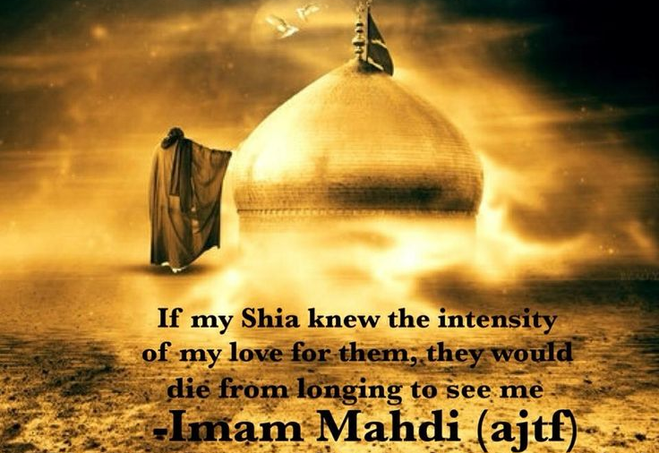
Notes:
intezar

Slide 10
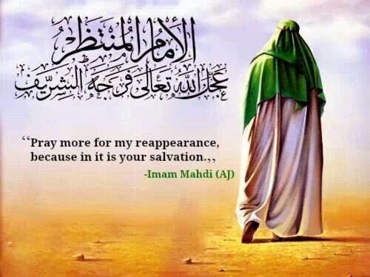
PRAY FOR THE IMAM

Slide 11
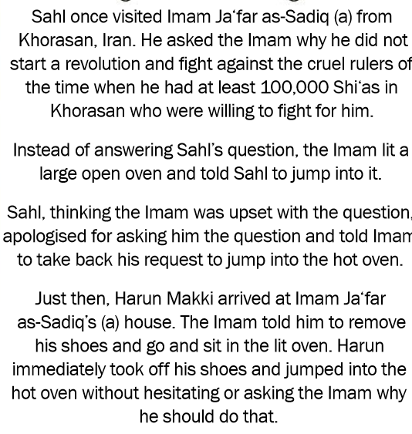
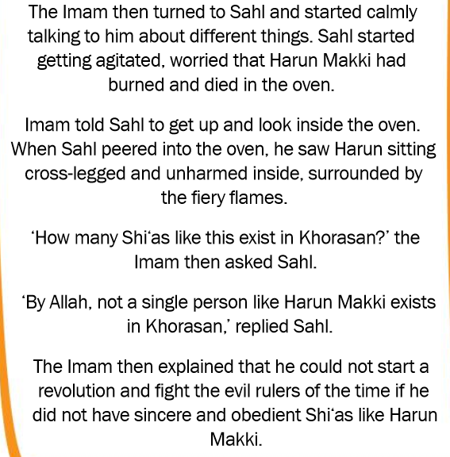
The story of sahl

Slide 12
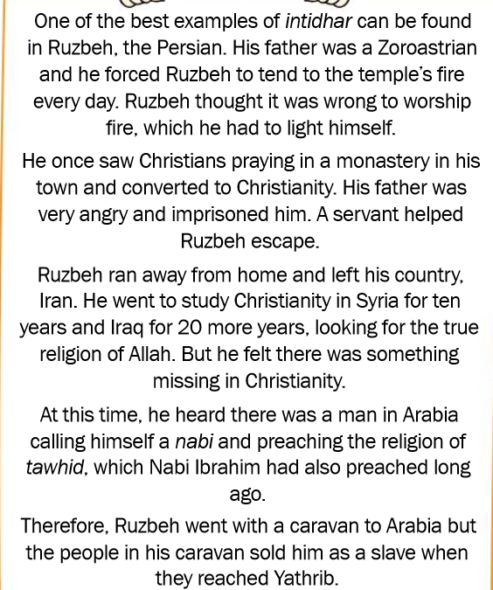
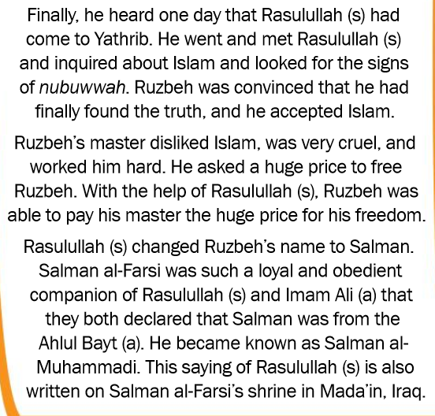
The STORY OF RUBZEH THE PERSIAN

