Slide 1
IMAM JA’FAR AS-SADIQ(A) AND HARD WORK
MODULE 4A - LESSON 8

Slide 2
Learning Objectives
Imam Ja’fer as-Sadiq is our Sixth Imam.
Qualities of our Sixth Imam.
What quality you would like to learn and apply to keep our Sixth Imam happy.

Slide 3





Let’s have a look at our IMAMS!! (can you match them?)
Imam Mohammed Baqir(as)
Imam Hasan (as)
Imam Ali Zayn al-Abidin(as)
Imam Hussain (as)
Imam Ali (as)

Slide 4
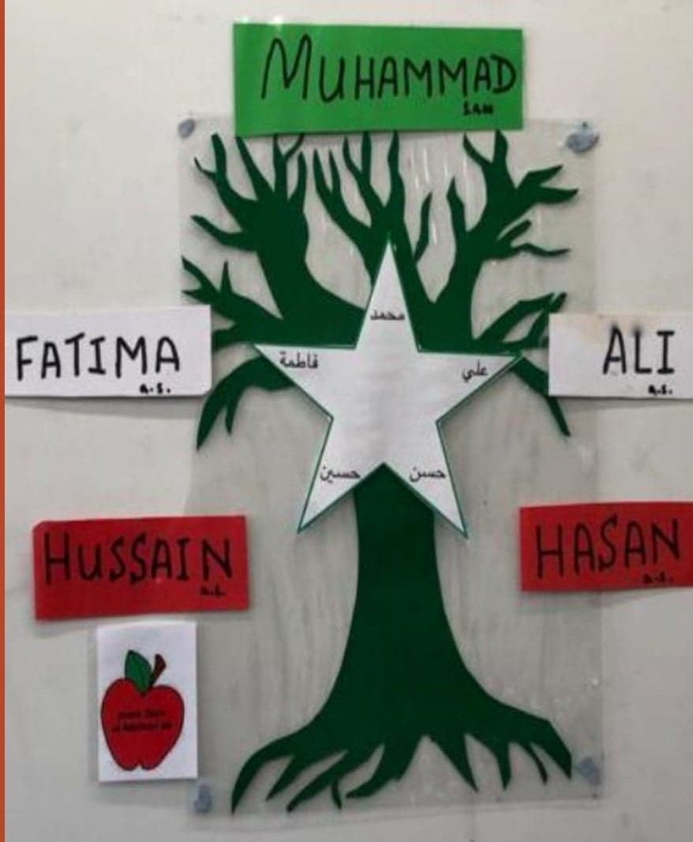
Family tree of Imam Ja’fer as-Sadiq.
Fatima (s)
Ali (a)
Hassan (a)
Hussain(a)
Fatima (s)
Wife of 4th Imam
Zayn ul-Abidin(a)
Baqir(a)
Ja’fer as-Sadiq(a)

Slide 5


Introduction of our Imam Ja’fer as- Sadiq(a)
Look at the family tree and tell me who is the grandfather of our sixth Imam.
Imam Zayn al-Abidin (a)

Slide 6

When Imam Ja’fer as Sadiq (a) was born, Imam Zayn al-Abidin(a) his grandfather gave ADHAN in his right ear and IQAMAH in his left ear.

Slide 7
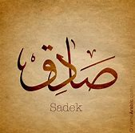
One of the tittles of our sixth imam is As-Sadiq which means the TRUTHFUL.
There’s some one else out of fourteen Masoomeen who has the same tittle as imam Ja’fer Sadiq.
Can you guess who could it be…..
Yes!!!! You are correct, it’s our beloved Prophet Muhammed(saww).

Slide 8
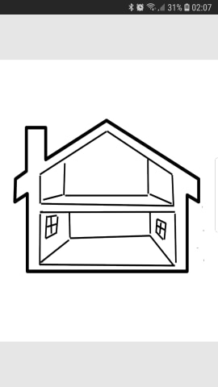

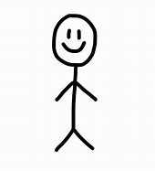

As a child Imam Ja’fer Sadiq lived with his father and grand father.
Draw a picture of two people living in the house, one is grand-dad and the other is dad and number them accordingly.
House of Imam Zayn al Abidin(a)

Slide 9

Imam has always worked hard and showed his best in achieving any task
He worked hard to spread knowledge.
He worked hard to build.
He worked hard to help others.
He worked hard to farm and earn money for his family.
He worked hard to gain knowledge.

Slide 10

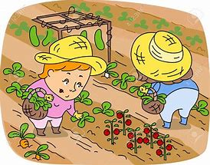
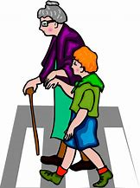
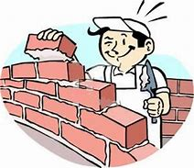
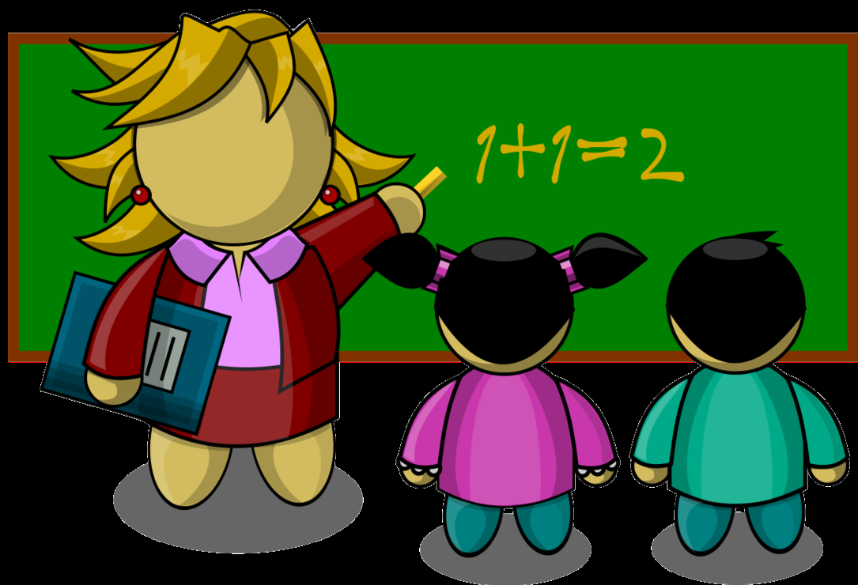
Gaining knowledge
So my children which characteristic of Imam Ja’fer Sadiq, would you like to apply in your daily life?
I would love to hear it when we are back in Madressa!!!
Farming
Helping others
Working hard to build
Spreading knowledge

Slide 11


