Slide 1
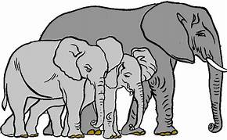
The story about ’Ashabul feel – The people of the elephant’

Slide 2
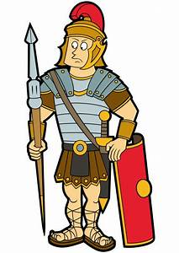
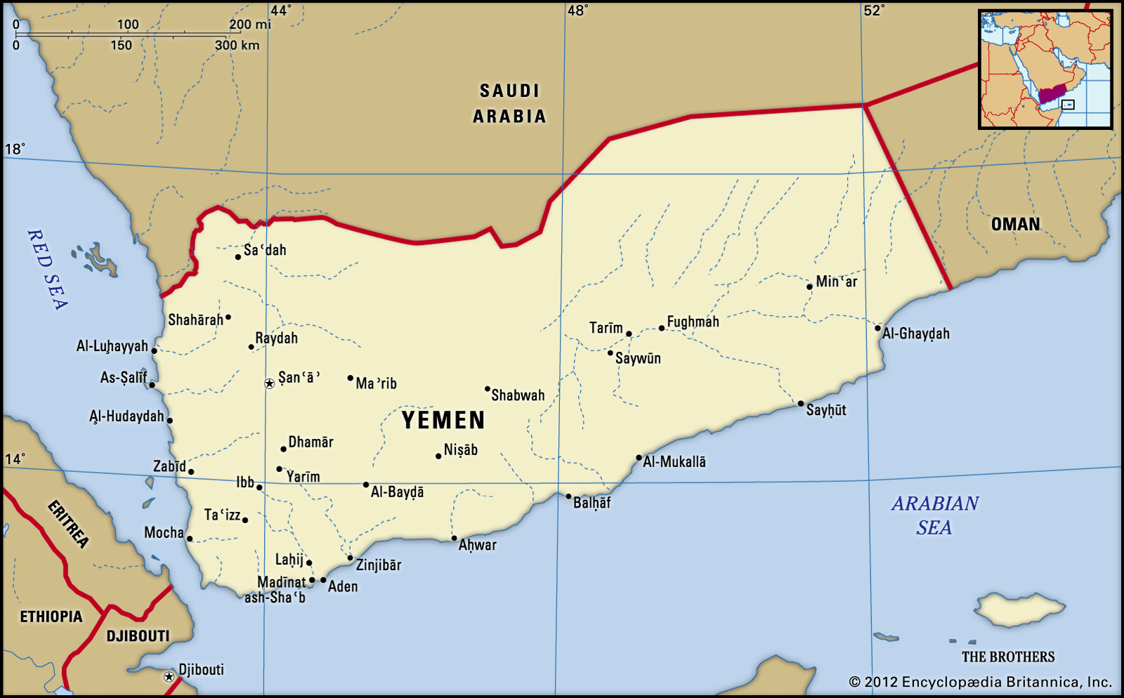
Long time ago, there was a Christian
ruler in Yemen called Abraha.

Slide 3
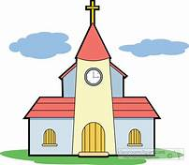
Abraha built a huge church in Yemen. He wanted people to come and worship at the huge church.

Slide 4
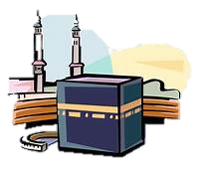
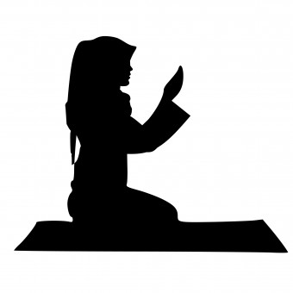
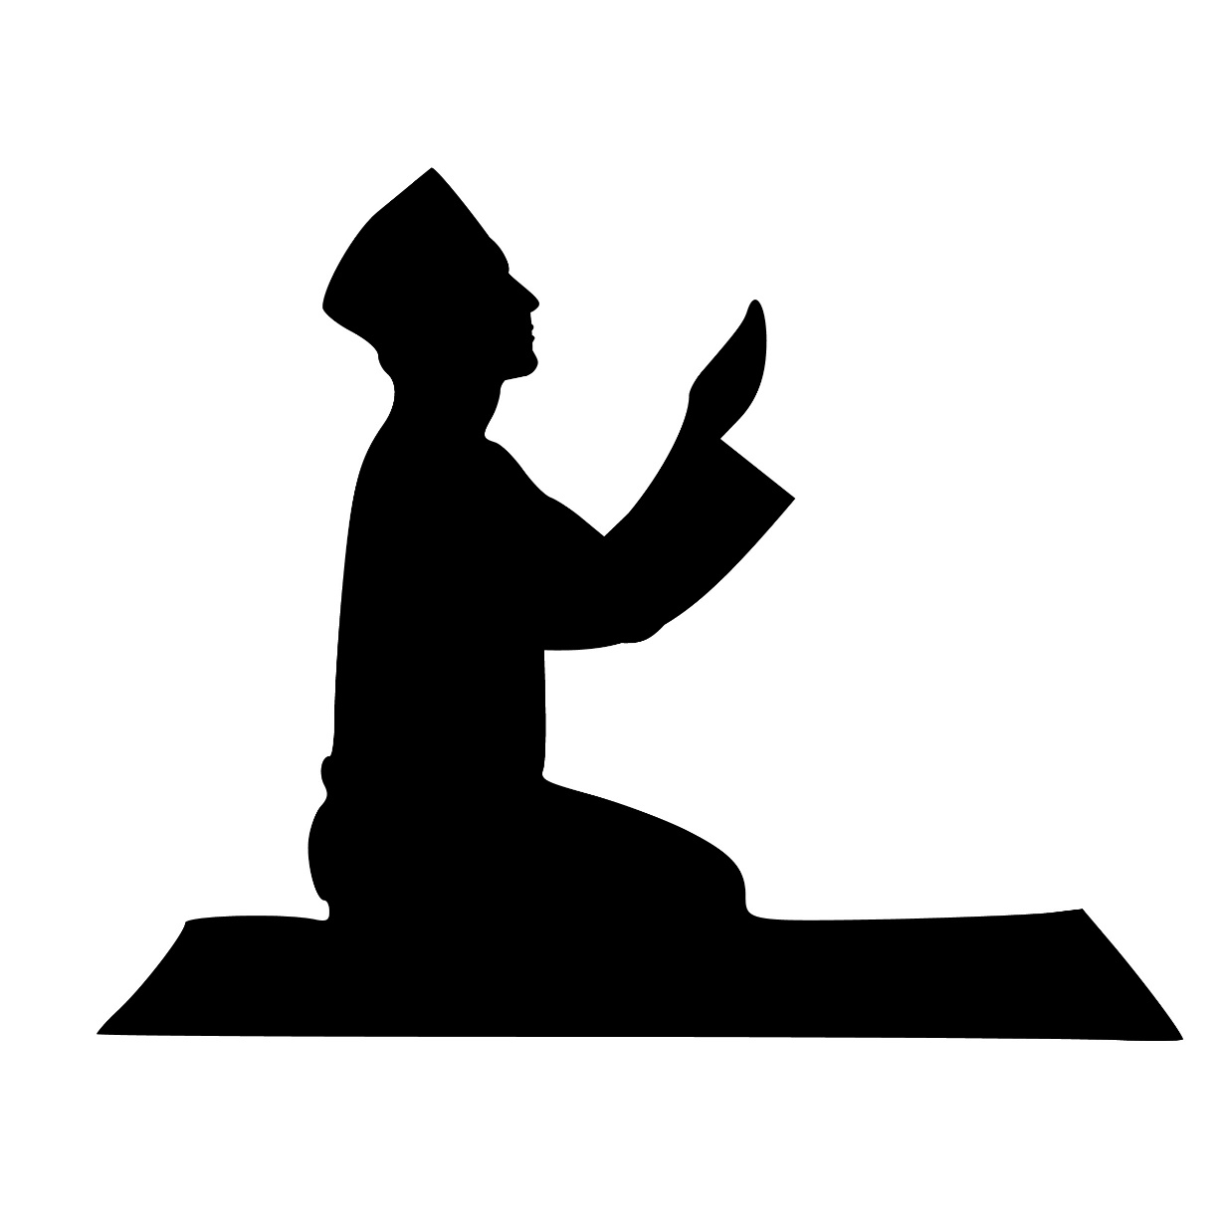
But the people would go to the Ka’bah in Mecca instead.
When he saw nobody was interested in his church, he decided to destroy the Ka’bah.

Slide 5

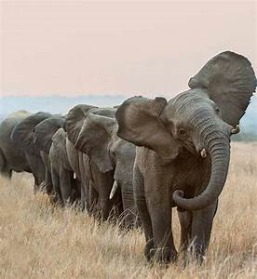
Abraha formed a large army and marched towards Mecca.
His army had elephants. That is why they were known as ’Ashabul feel – The people of the elephant’

Slide 6

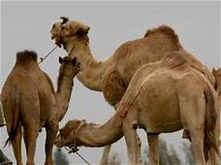
When he reached Mecca, he captured some camels belonging to Abdul Muttalib (Rasulullah’s (s) grandfather)

Slide 7





Abdul Muttalib went to Abraha to ask for his camels back.
Abraha was puzzled – he had come to destroy the Ka’bah and Abdul Muttalib was thinking about his camels!

Slide 8


I am the owner of my camels and it is my job to protect them. The Ka‘bah is the house of Allah, and He will protect it.

Slide 9


Abraha ignored this warning and took his army of elephants to destroy the Ka’bah.

Slide 10
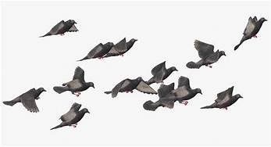


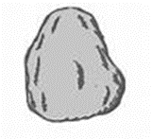
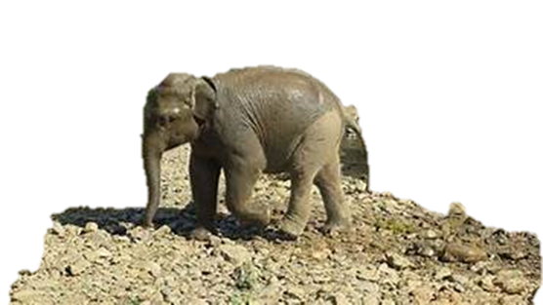
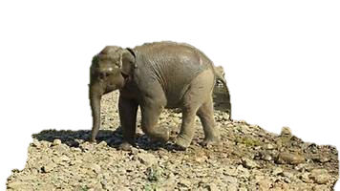
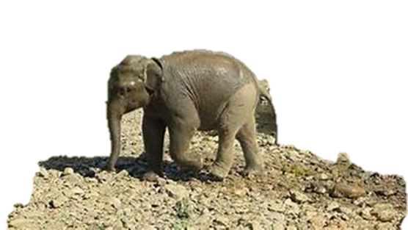
Allah sent down small birds with stones in their beaks, these stones crushed Abraha’s army.

Slide 11
Even though the birds were tiny, their effect was great because they had the help of Allah.
The Ka’bah was saved and Abraha’s army was destroyed!

Slide 12
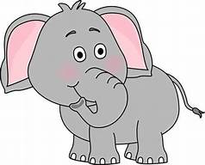

The year this event took place is known as ‘Aam al feel: the year of the elephant’. Rasulullah (s) was born in this year.
There is a Surah in the Qur’an about this story. It is called the Surah of the elephant – Surat al Feel.
‘Feel’ means elephant in Arabic

