Slide 1
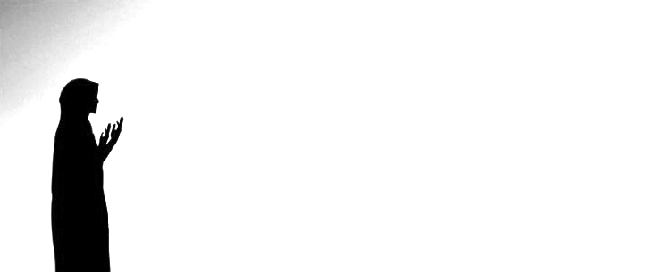

Du’a
i ask allah for Help
1B05

Slide 2
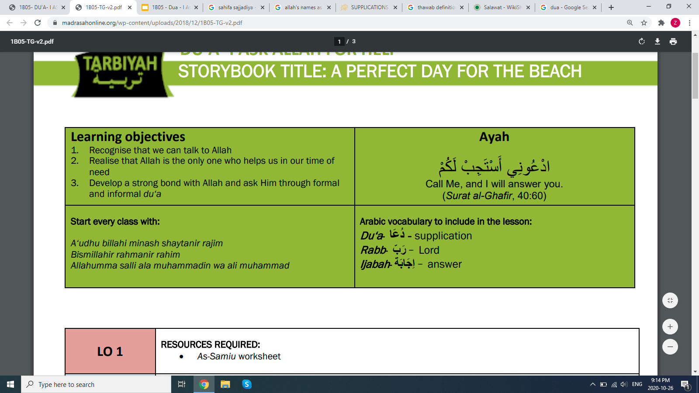

Slide 3


Allah's line is never busy!
No matter how many people call on Allah, He listens to everyone! No matter how many people around the world call on Him, He hears them all!
He hears even when we just think something in our head.
He knows what we are thinking and feeling all the time!
Notes:
Series of multiple choice questions on quizizz before this slide, yes no questions, etc.

Slide 4
As-Samiu
He hears everything

Slide 5
Mind Map Activity
HOW DO WE TALK TO ALLAH?
In sajdah
On a blank piece of paper, create a mind map. In the middle write the name of Allah - As Samiu
Around it, write or draw all of the ways we can talk to Allah
AS SAMEEU
The All Hearing
Thinking in our mind
Notes:
Individual activity, can share their papers on camera once they are done

Slide 6

Who is this?
What does he do?
What are his superpowers?
Notes:
Discussion with class

Slide 7

What about our Masumin (a)?
What are Allah’s superpowers?
Who did Imam Ali (a) or Rasulullah (s) or any of our other Masumin (a) call out when they were in need?
Who will you call out to when you are in need?
Notes:
Get class to think about these questions, quiz questions to follow so that everyone can share an answer
There is a video in the teaching guide for this part, I think we can watch it at the end if there is extra time. Link below.
https://www.youtube.com/watch?v=yEO34LWeZqc

Slide 8


What does the siren on an ambulance represent?
Have you ever prayed for the person in the Ambulance when you heard the siren?
Notes:
Before this slide quiz questions
Ask them whether it is better to pray for ourselves or for others Ask them who they normally remember in their prayers. What do they normally say when they pray for others?
Discussion, siren means

Slide 9

Dua we recite for people who are Ill or in Difficulty
أَمَّن يُجِيبُ الْمُضْطَرَّ إِذَا دَعَاهُ وَيَكْشِفُ السُّوءَ
Du’a is a special secret gift you give someone. It is a secret gift between you and Allah (swt) and a secret gift to that person!

Slide 10
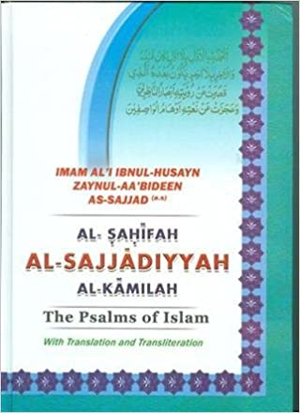
WHICH ONE OF OUR IMAMS CAN BE CALLED THE “DU’A CHAMP”?
Imam Zayn al-Abidin (a) wrote a du’a book with du’as for everything!
Du’as for each day of the week to du’as for angels.
Have you ever prayed for the angels?

Slide 11
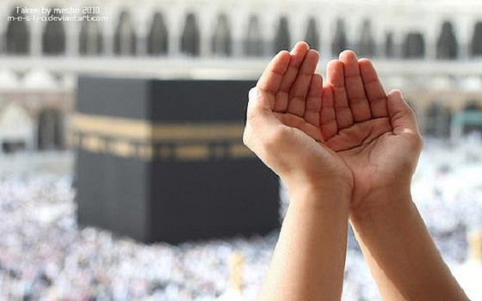
Du’a for lots of Thawab (reward)
اللهم صل علی محمد و آل محمد
Allāhumm-a Ṣall-i 'Alā Muḥammad-in Wa Al-i Muḥammad
We pray for Allah to shower blessings on the Rasulullah (s) and his family and in return Allah gives us so much thawab and lots and lots of blessings too!

Slide 12
Allah promises us “ud‘uni astajiblakum. Call Me, I will answer you”
If Allah promises something, he keeps it!

