Slide 1

Welcome Back Everyone

Slide 2
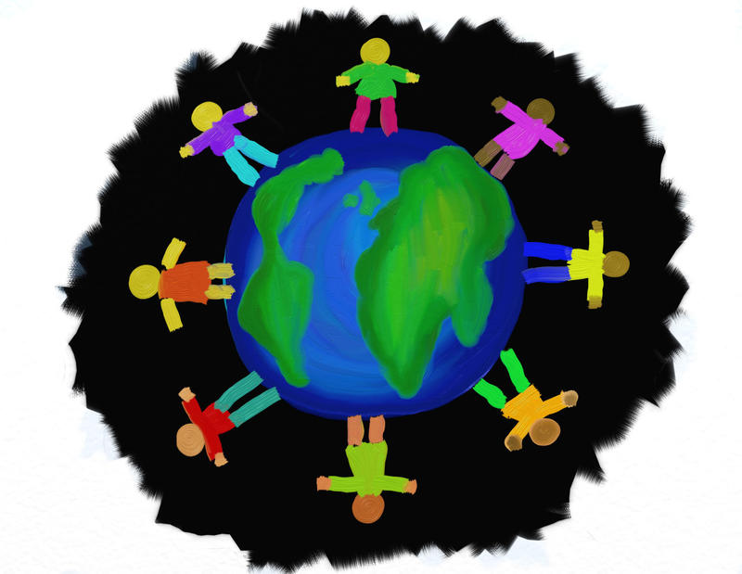
Recap of the Last Lesson
Nabi Adam was the First Human being
He was the first Nabi
His wife’s name was Hawwa
We are all the children of Nabi Adam and we are called the “Bani Adam”

Slide 3
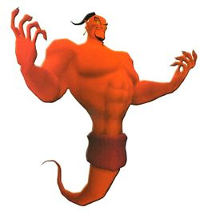
The Story of Nabi Adam
Iblis:
He was a Jinn
He lived in paradise with the angels
Worshipped Allah
Made from smokeless fire
Refused to bow down to Adam
Was the first creation to show pride
Is called Shaytan

Slide 4
Lesson Learnt from the Story of Iblis and Adam
Never be proud

Slide 5

Activity time

Slide 6
What are these footballers doing?
https://www.youtube.com/watch?v=FfvV5YtRKOQ

Slide 7
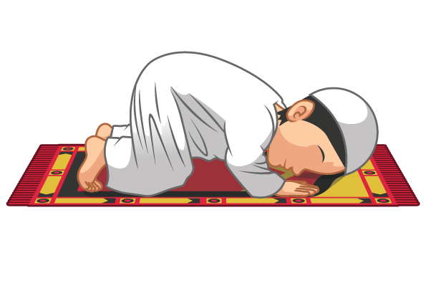
Sajdah
Best way to remove pride
Reminds us that everything we do is because of Allah

Slide 8
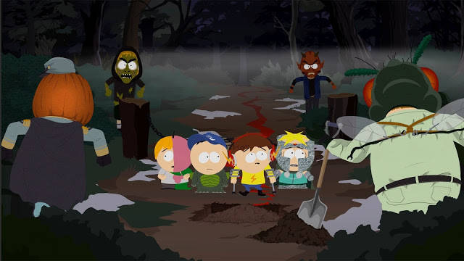
Shaytan attacks from all sides
Except from above and below
Raise your hands up or Go to Sajdah when you need Allah's help and He will always answer!

Slide 9
Let's all Do sajdah together to thank Allah for this defence against Shaytan!

Slide 10
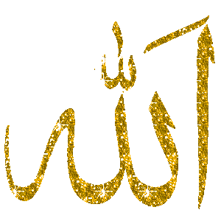
Always Remember!
Pride is only for Allah
Only he is Al- Mutakabbir – “The Supreme”
He is above everyone

Slide 11

Humble Vs Proud

Slide 12
Lessons Learnt
Pride destroys everything: Friendship, relationships, happiness and even yourself
Always be humble
Allah does not like the proud but loves the humble

Slide 13
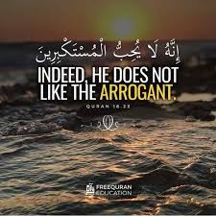
What does Allah say about the proud in the Quran?

Slide 14

Rhyme Time

Slide 15
Activity time

Slide 16

Story Time

