Slide 1
NABI ISA AND SAYYIDAH MARYAM
MODULE 2A
LESSON 6

Slide 2

Learning Objectives
Identify that Nabi Isa (as) was the sone of Sayyidah Maryam.
Recognise that Nabi Isa (as) is the sign of Allah (swt).
Allah can do anything He wills.

Slide 3
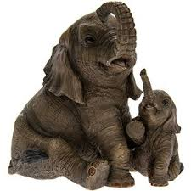
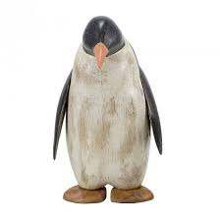
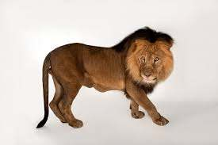
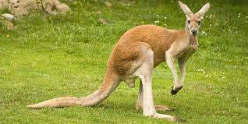
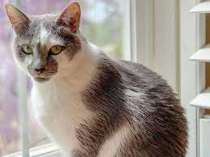
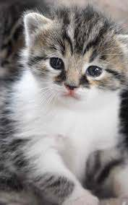
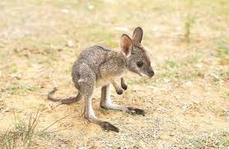
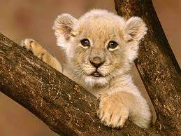
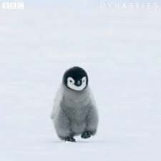
Match the Mummy to their Babies

Slide 4
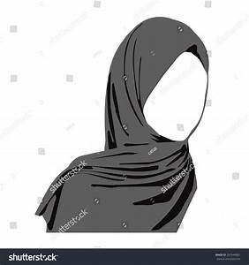
Do you know who is the mother of Nabi Isa (as)
Her name is Sayyidah Maryam (as)
Her dad’s name is Imran (as)
Her mum is called Hannah (sa)

Slide 5


Show me your picture with your mummy when you are a baby

Slide 6
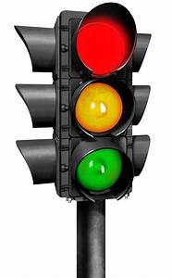




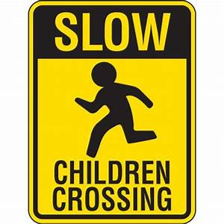
Where do you see these signs?

Slide 7


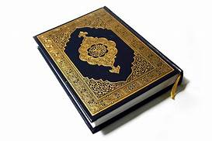
What does a Sign means?
Sign
Sign is there to gives us a message
It tells us something really important
Arabic word for signs is AYAT or AYAH
Have your heard of this before?
YES!!!!!!
The Quran is made up of Ayahs. They are all signs
pointing us towards Allah’s Greatness

Slide 8

STORY TIME!!!!!!
Make sure you all listen to the story carefully as there is a sign of Allah (swt) in the story….

Slide 9
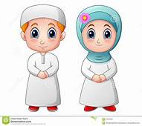

A long time ago, there was a lady called Hannah, and her husband was called Imran. They did not have any children. Hannah prayed to Allah and Allah gave her a baby girl! They named her Maryam. Because Hannah was so thankful to Allah for this gift, she told Allah that she would gift her daughter to the ma‘bad - the place of worship.

Slide 10
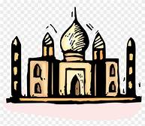
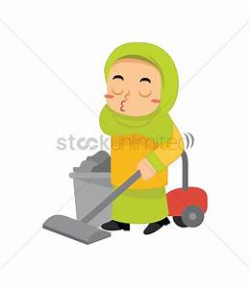
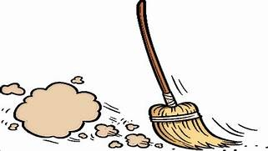
When Sayyidah Maryam was a little older, her mother took her to the ma‘bad where she asked Nabi Zakariya(another Prophet of Allah)to look after her. He did so and she grew up worshipping Allah whilst working hard in the ma‘bad.

Slide 11
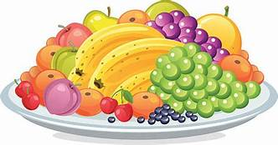
One day, Nabi Zakariya visited Sayyidah Maryam in her room. She had such lovely food in front of her. Nabi Zakariya asked “Where does this food come from?” Sayyidah Maryam replied, “From Allah, Allah gives to everyone who He wants”

Slide 12

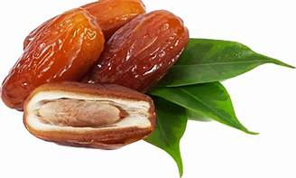
Sayyidah Maryam grew up. Allah told her she would soon have a baby. Allah guided her to go towards a palm tree in the desert. There Sayyidah Maryam has her baby boy. She shook the palm tree and dates fell for her to eat. A beautiful stream flowed nearby her feet. Sayyidah Maryam could drink from the beautiful stream.

Slide 13
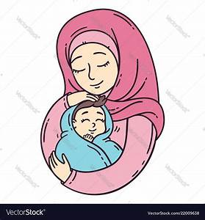

Sayyidah Maryam then returned back to the place she was living. The people saw Sayyidah Maryam. They also saw the beautiful baby. Allah asked Sayyidah Maryam to point to the baby. When she did, the baby spoke!
He said: “I am Allah’s servant. He has made me a prophet. He has made me loving to my mummy, Sayyidah Maryam.”

Slide 14

The people were amazed at the talking baby! The baby was Nabi Isa. He showed that Allah can do whatever He wants and that him talking was a sign of Allah!”

Slide 15
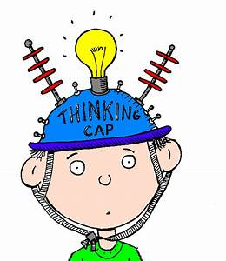

Do you remember the sign of Allah (swt)
When Nabi Isa talked as a new baby, it was a sign for all the people around him from Allah.
Allah can make anything happen!
What age did you said your first word?

Slide 16
Ayah of the Day !!!
إِنَّ اللَّهَ عَلَىٰ كُلِّ شَيْءٍ قَدِيرٌ
Indeed, Allah has power over all things.(Surat Baqarah, 2:20)

