Slide 1

NABI ADAM AND LADY HAWWA
Module 1B, Lesson 3
Notes:
A‘udhu billahi minash shaytanir rajim Bismillahir rahmanir rahim Allahumma salli ala muhammadin wa ali muhammad

Slide 2
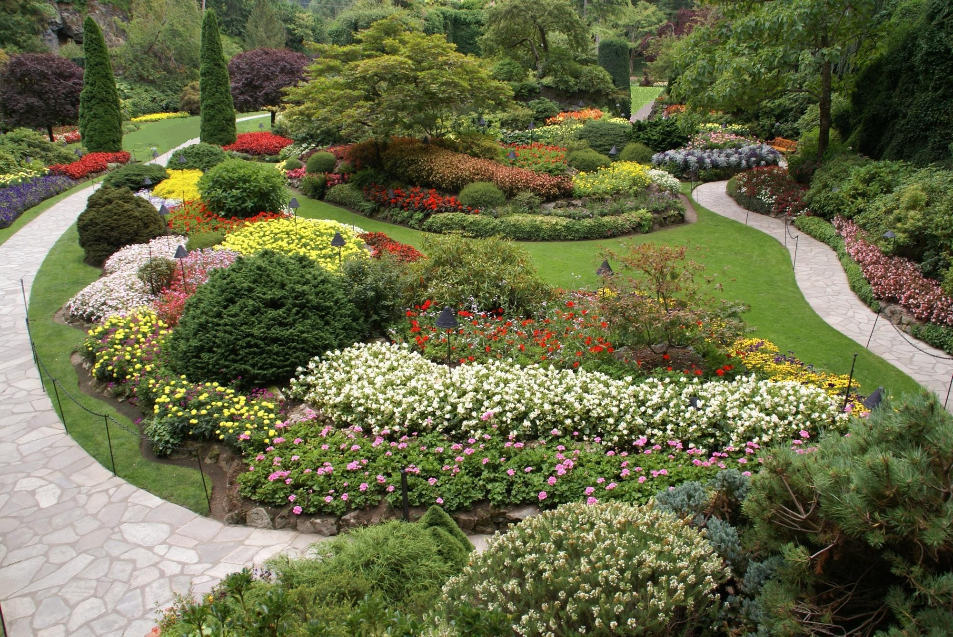
Is anything missing from this picture?
Who in the picture is enjoying Allah’s beautiful creations?
Notes:
Ask the children to look at this picture and point out if anything is missing.
Hint to them by asking who in the picture is enjoying these beautiful creations of Allah. Elicit that there is no person in the picture, only other creations of Allah.
Highlight that after Allah had created all His amazing creations, He decided it was time to create the best and the last – a human being!

Slide 3
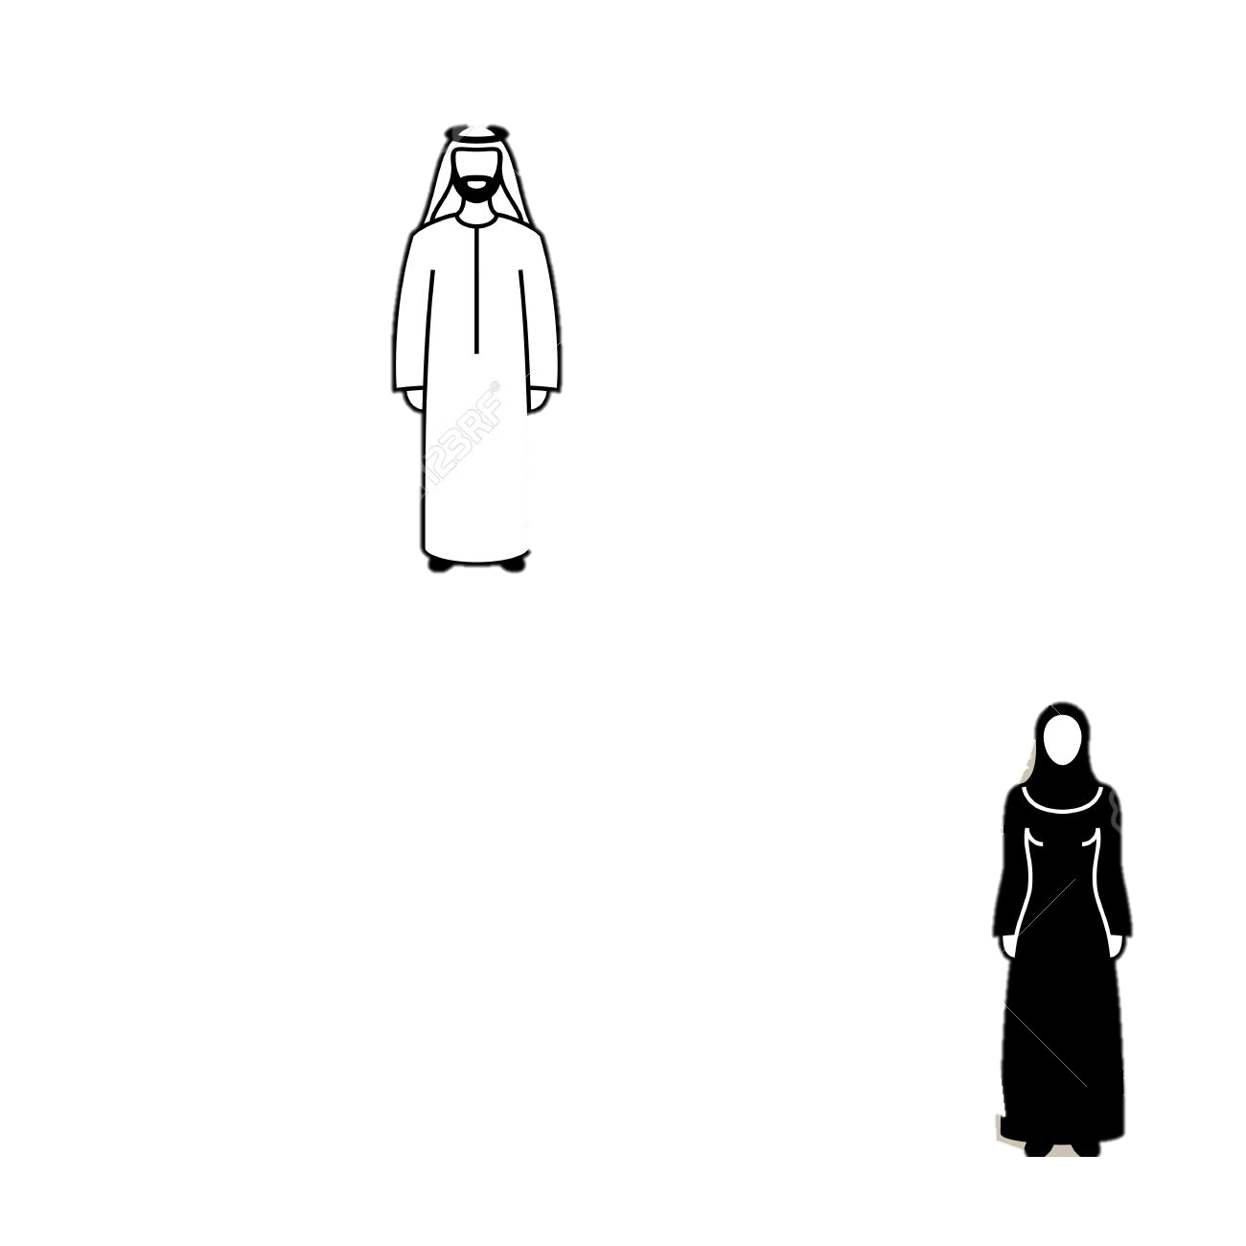
If you were the only human in this garden, what else would you wish for?
Nabi Adam
What else needs to be put in the picture to complete it?
Lady Hawwa
Notes:
On the original image you had placed at the beginning of the lesson, place an outline of a man labelled Adam on the scene.
Ask the kids if the scene could be made any better.
Ask them if they were the human in this garden, what else would they wish for? Allow them to realize that it’s lonely to be all by yourself with no one to play with etc.
Next, ask them what else needs to be put in the picture to complete it? Place an outline of a woman. Ask them if this reminds them of any Nabi of Allah?
Highlight that he was very happy in this garden as he got to know all of Allah’s creation. Soon, though, he began to feel lonely and so Allah created a partner for him, Lady Hawwa! He used some of the same earth He had used for Nabi Adam and from this, made Lady Hawwa. The two of them lived happily in this garden and loved each other very much.

Slide 4
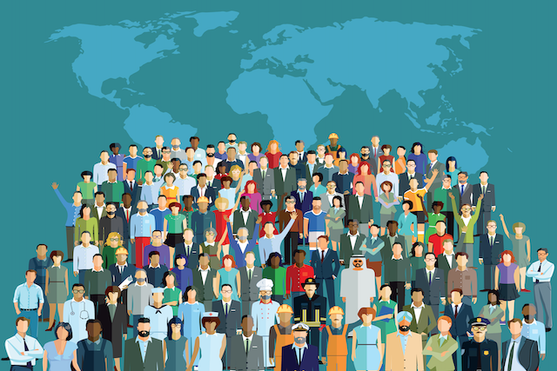
Nabi Adam and Sayyeda Hawwa had children, and this is how the human population grew.
Bani Adam ﺑﻨَﻲ ِ آدم -
Children of Adam
Nabi Adam
Lady Hawwa
Notes:
They were then sent down to live on the earth, as Allah had made them from earth. They got used to life here. They had children and gradually this is how the human population grew. Allah Himself tells us in the Qur’an that He created us in “pairs”.

Slide 5
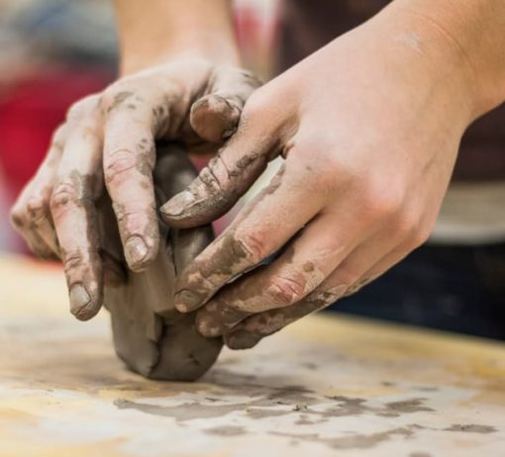
Allah asked his angels to collect various types of earth from all over and then using them He created the shape of a human.
Notes:
Talk about the process employed by Allah to create Nabi Adam.
He asked His angels to collect various types of earth from all over and then using them, He created the shape of a human.
Pretend you have a collection of wet sand and mud and try to mold it into the shape of a human

Slide 6
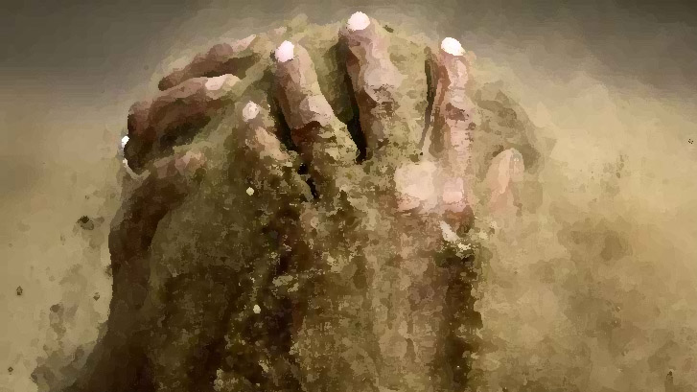
Can the clay model talk or move or breathe?
Humans are made of 2 elements –
1) Soul
2) Body
Notes:
Now ask them if their shape can talk or move or breathe. Ask them why not. Explain that humans are composed of two elements – the soul and the body.
The body is the physical form we see and the soul is the unseen thing which gives us life and the ability to move our bodies.
(You can remind them of the previous lesson (1B02) in which they learnt about seen and unseen creations of Allah).
Inform the children that Allah gave Nabi Adam’s body a soul and then he began to move and talk.
Allah tells us in the Qur’an: And I breathed into him My spirit (Surah Saad, 38:72)
Remind them that Allah doesn’t have a body or a mouth and the word breathe here is used in the Qur’an just to make us understand that Allah gave him life.
Ask the children to blow as hard as they can – if you blew into a clay model, would it come to life? Remind them:
Only Allah creates us and gives us life.

Slide 7
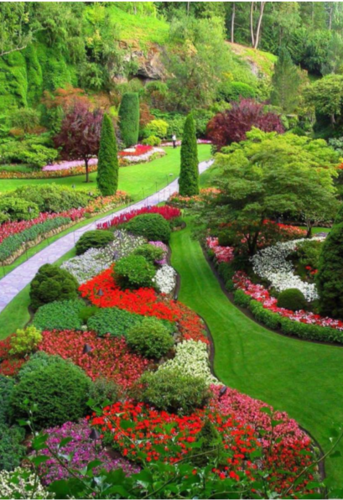
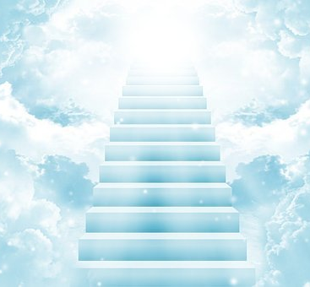
Nabi Adam was not only the first man to be created, but also the first Nabi that was sent down by Allah
Nabi ﻧَﺒﻲ - prophet
Prophet of Allah, whom He has chosen among His people
Notes:
Highlight the fact that Nabi Adam was created in the heavens, in front of the angels who were asked to bow down to him as a command from Allah. Nabi Adam stayed in a beautiful garden and Allah taught him everything he needed to know, including the names of the surrounding creations, and introduced him to the angels of course.
Highlight how Nabi Adam was not only the first man to be created, but also the first Nabi that was sent down by Allah.
Make them recall that a Nabi is a Prophet of Allah, whom He has chosen among His people.

Slide 8
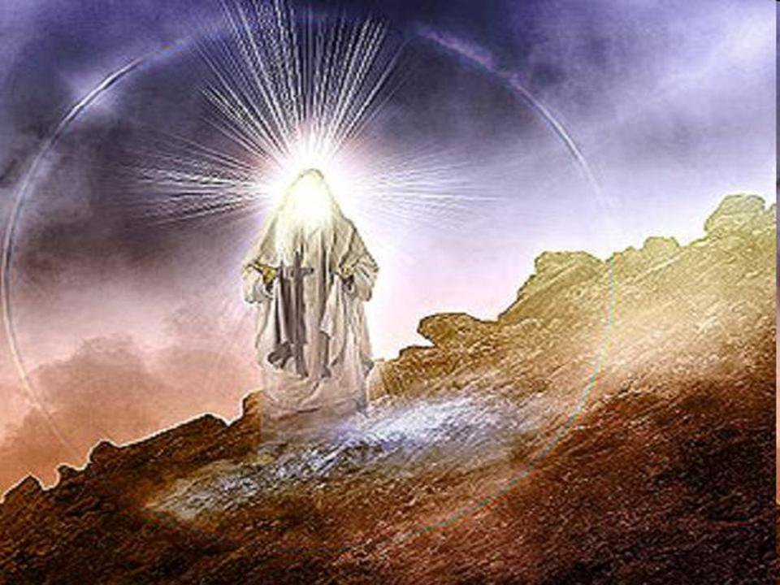
How many Ambiya has Allah sent?
Can you name any of our Ambiya?
Ambiyaاَﻧْﺒِﯿَﺎء - Prophets
Ambiya were sent so that they could teach their people about one God and guide them on to the right path.
Notes:
Ask how many Ambiya Allah had sent and why the need for Ambiya.
Brainstorm on the board as many Ambiya the children can think of.
Ensure they recall the reason for them being sent was so that they could teach their people about one God and guide them on to the right path.

Slide 9

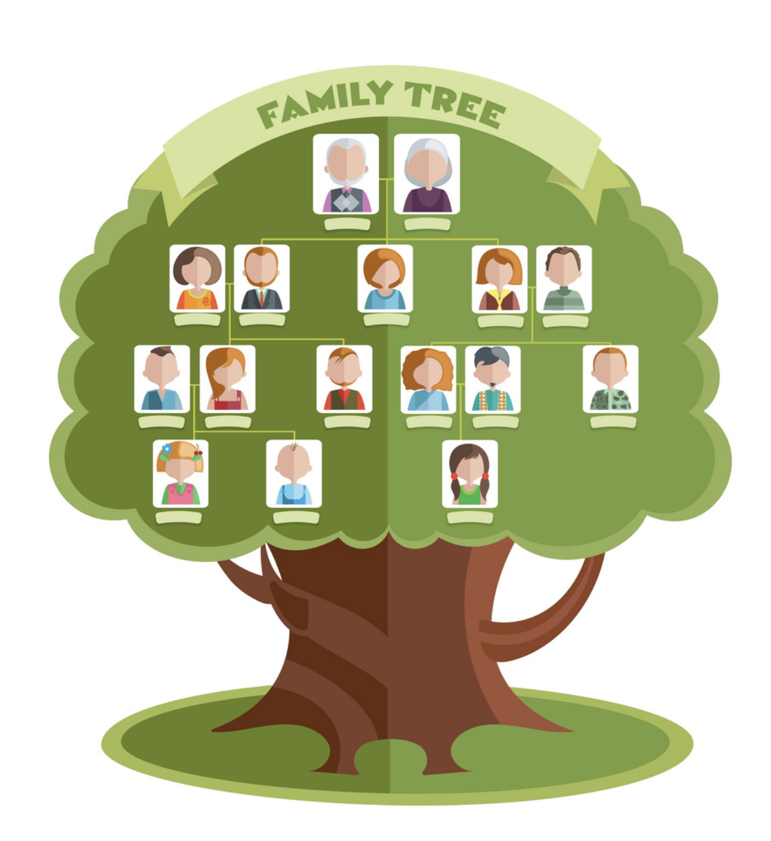
We are all Bani Adam!
Bani Adam - ﺑﻨَﻲ ِ آدم
Children of Adam
وَلَقَدْ كَرَّمْنَا بَنِي آدَمَ
We have given Bani Adam respect
(Surat al-Isra, 17:70)
YOU!
Notes:
Remind them that Nabi Adam and Lady Hawwa were the ones who had babies and that is how the population of this world grew. Tell them that if they were to draw a family tree, it would start with Nabi Adam and end with their families. Highlight the fact that Nabi Adam was our great great great (etc!) grandfather. The family tree would be called “Bani Adam”.
This is how Allah refers to us in the Qur'an.
Recite the ayah of the lesson with its meaning.

Slide 10
Lesson Summary
Recall
Recall that the first person to be created was Nabi Adam
Recognise
Recognize that Nabi Adam was the first Nabi
Conclude
Conclude that all of us came from Nabi Adam and hence we are known as Bani Adam

