Slide 1
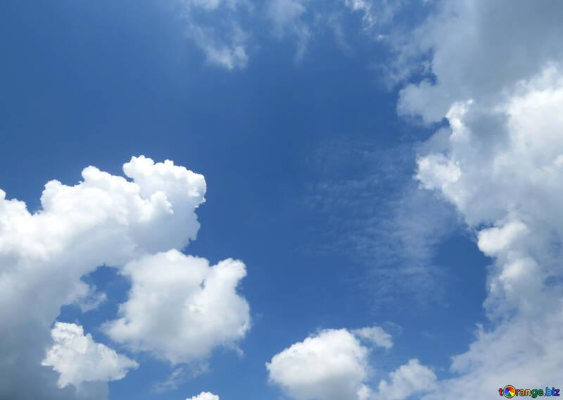
Tarbiyah 1B02
Allah made Angels, Jinns and Animals

Slide 2
Allah created...
Humans
Animals
Jinn
Angels
Notes:
Allah (swt) created different creatures. Besides animals and humans who else has Allah created?

Slide 3
Allah’s Creatures
Free Choice
No Free Choice
Humans
Animals
Jinn
Angels
Notes:
Out of jinn, angels, animals and us humans, whom has Allah created with the ability to make a decision for themselves and do right or wrong?
This means that on the Day of Judgement just like humans, jinn will also be accountable for what they do in this world.

Slide 4

Before Nabi Adam, Allah created the Angels!
ISRAFIL
JIBRA’IL
MIKA'IL
IZRA'IL
MUNKAR/NAKEER
Notes:
What do you know about Angels?
Angels are mentioned many times in the Qur’an.
Some of the Angels you may have heard about are Jibra‘il, Mika‘il, Israfil, Izra’il, Munkar/ Nakeer and Kiramun Katibin (Raqib/Atid).
Angels are made from nur (light) and have wings. They can appear in the form of humans (an example of the one that came to Sayyidah Maryam). Most importantly, they never disobey Allah and have no free choice like humans. They are all assigned various duties and they do these continuously – they do not eat or sleep or get tired.
Ask the children to stand up and then stand on one leg for as long as they can. How long did they manage? How did they feel after a while?
Angels have no such feelings of finding things hard or getting tired, they simply do what Allah has asked them to do!

Slide 5


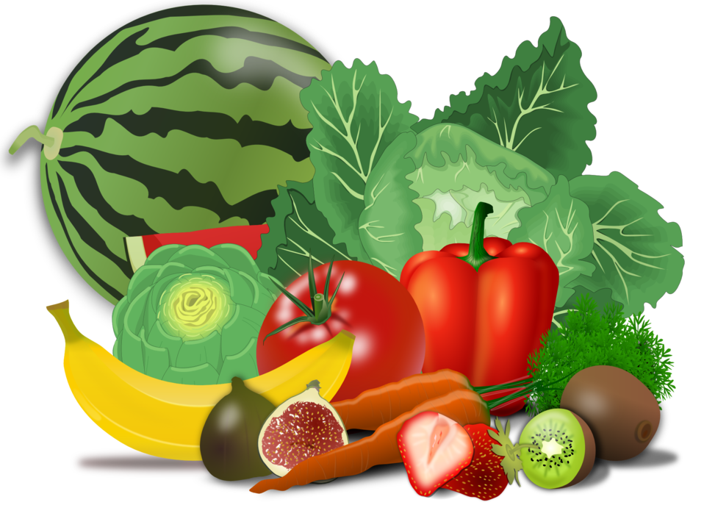
Angel Jibra’il
In charge of bringing Allah’s words to His prophets.
Angel Mika’il
In charge of rain and rizq (like food).

Slide 6



Angel Israfil
In charge of blowing the trumpet to mark the day of judgment.
Angels Raqib and Atid (Kiramun Katibeen)
In charge of writing down our deeds.

Slide 7


Angel Izra’il
In charge of taking the soul at the time of death.
Angels Munkar and Nakeer
Will question us in the grave about our faith and deeds.
Notes:
We can use kahoot or zoom polls at the end to try to mimic the flashcards we do every year

Slide 8

Some creations of Allah are SEEN and some are UNSEEN
Notes:
Explain what seen and unseen means if they do not understand. Allow them to discover that animals are seen creations just like us.
(Can use Google Jamboard, Zoom Whiteboard, an actual whiteboard, (or even post-its on a wall with painter’s tape for lines) for this activity.)
Draw a table with 2 columns. Label one column seen and the other unseen. Provide words to every student (or ask them) to think of some of Allah’s creations that are seen and unseen. (Examples of unseen – Air, Wind, Jannah, Angels, Imam Mahdi (a), Allah)
Briefly, go over their decision.
Use the word ghaib when talking about unseen so that they can connect it to the ayah and the example of Imam al- Mahdi (a).

Slide 9
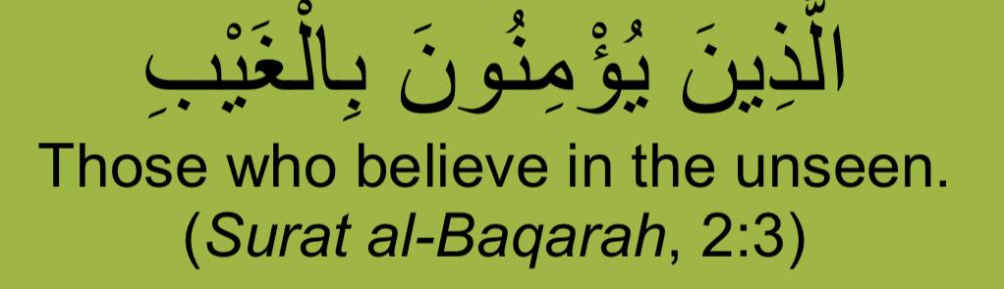
Ayah
Notes:
Read the ayah and it’s meaning to them a few times. Highlight that part of our faith is believing in the unseen.

Slide 10
Learning Goals
Identify that Allah has created the angels, jinn and animals
2. Give examples of some angels and their duties
3. Categorize Allah’s creations into the seen and unseen and outline the differences between them

