Slide 1
SURAT AL IKHLAS

Slide 2


Slide 3
What does the surah mean?

Slide 4
MEANING
SAMAD
AHAD
Allah is He on whom all depend
ONE

Slide 5
Allah is He on whom all depend
AHAD
SAMAD
ONE

Slide 6

Qiyamah/ Ma'ad
Tawheed
Imamah
Adalah
Nubuwwah

Slide 7
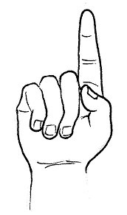
Say He is Allah, the One
TAWHEED
Allah is One

Slide 8
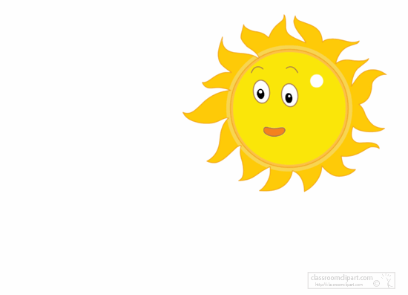
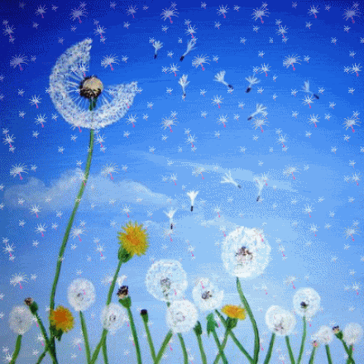
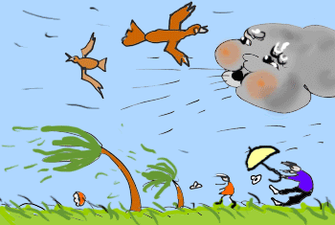
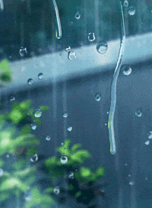
I want only the Sun
I love the snow
I love thunderstorms
I want only the night

Slide 9
What if the Sun never set?
What season should we have all year round?
What kind of a day should it be?
What if it was night all year round?

Slide 10

SHIRK
SHIRK
One of the biggest Sins
To believe in more than one God

Slide 11

Allah
Does Allah have parents?
Does Allah have children?
Lam yalid wa lam yoolad 3. He [Allah] does not have children and He does not have parents

Slide 12
https://www.youtube.com/watch?v=Qd6nLM2QlWw

Slide 13
Can anyone create something so beautiful?
What if……

Slide 14

Wa lam yakul-lahu kufuwan ahad 4. And there is no one like Him (Allah)

Slide 15
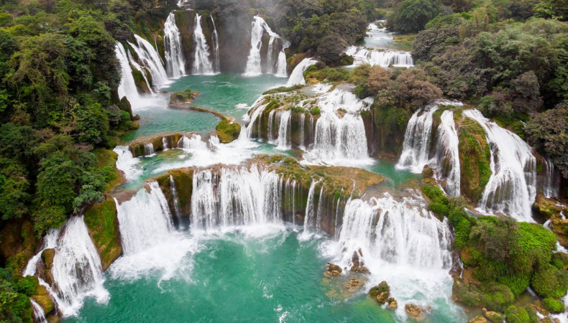
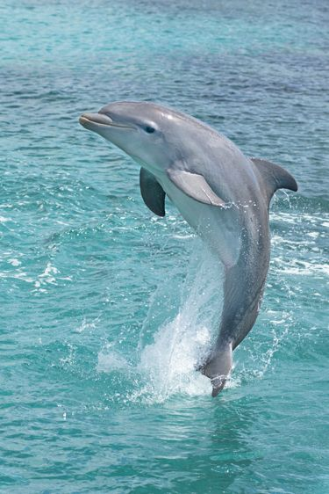
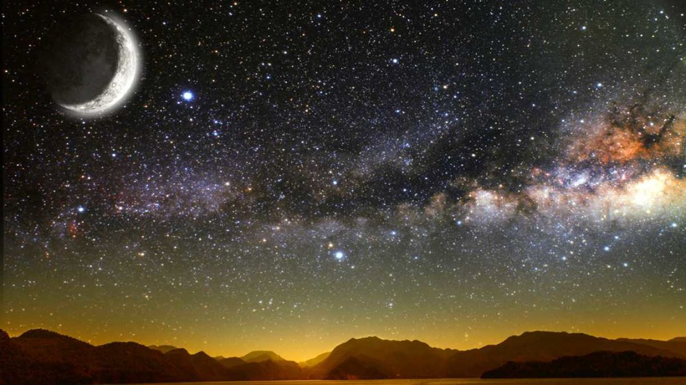

Slide 16
The most beautiful creation of Allah…
Human Beings

