Slide 1
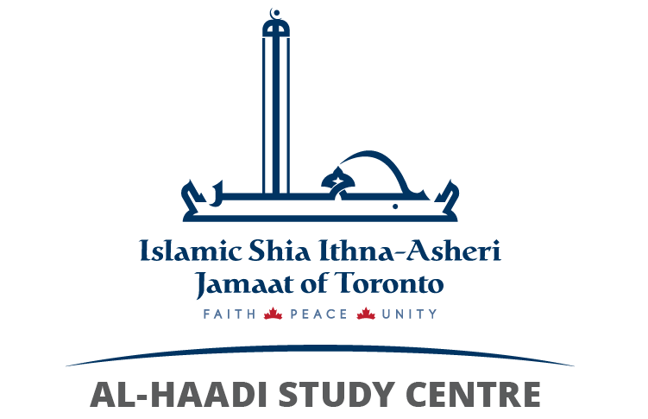
ALLAH IS ONE SURAT AL-IKHLAS
MODULE 1B, LESSON 1

Slide 2


Let us recite Surat al-Ikhlas
AHAD
SAMAD
ONE
HE DOES NOT NEED ANYONE, BUT EVERYONE NEEDS HIM
Notes:
Ask the children if any of them know how to recite Surat al-Ikhlas. Play a recording and let everyone recite together
Ask them what they think it means.
Show the words AHAD and SAMAD and ask them what they think they mean?

Slide 3
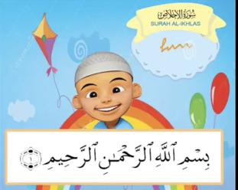
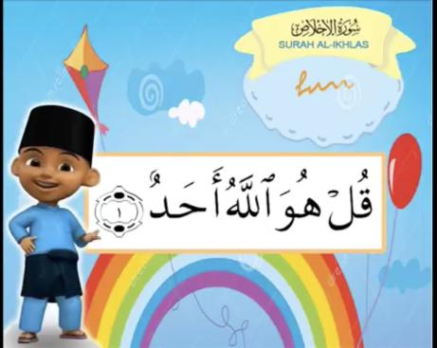
Let’s explore the meaning . . .
Say He Allah is One.
Notes:
Recite the first verse of Surat al-Ikhlas together.
Ask them what they think the first verse of the surah means.
Elicit “Say He Allah is One.”

Slide 4
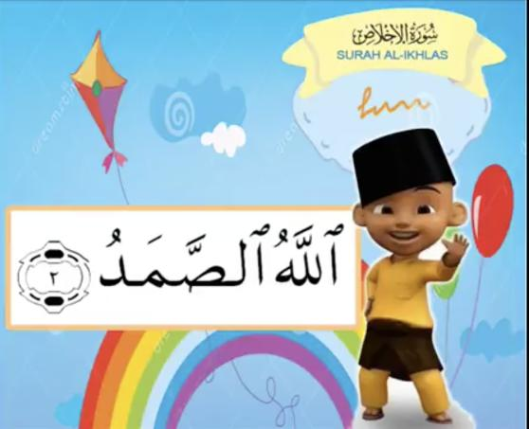
Allah does not need anyone.
Notes:
Recite the second verse of Surat al-Ikhlas together.
Ask them what they think the second verse of the surah means.
Elicit “Allah does not need anyone”

Slide 5

Usool e Deen
The Roots of Religion
Which usul
matches with
the verses of
Surat al-Ikhlas
that we recited?
Tawheed
Tawheed
Oneness of Allah
Ma’ad/Qiyamah
Return to Allah
Adalah
Justice of Allah
Imamat
Imamate
Nubuwwah
Prophethood
Notes:
Review the usool e deen – roots of religion.
Ask them, “Which usul matches with the verse of Surat al-Ikhlas that we recited?”
Sing rhyme and have them show their index finger – Allah is One.

Slide 6
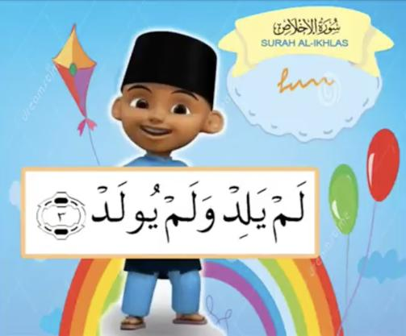
Does Allah have a son or daughter?
Was He created by someone?
He doesn’t have children,
He was not born.
Notes:
Ask them if Allah could have a son or a daughter?
Do they think He was created by someone? Remind them that if He had a son then that son would want to be God
and if He was created by someone then that someone would be superior to Him!
Recite the third verse of Surat al-Ikhlas together.
Ask them what it means.

Slide 7
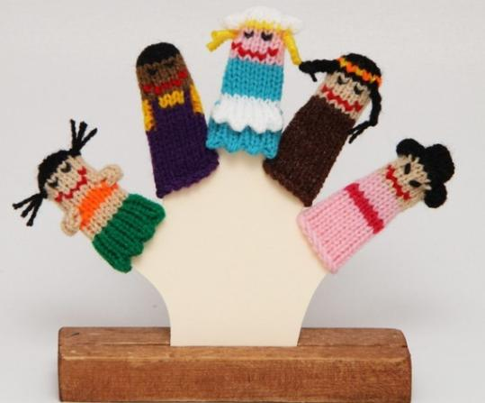
Worshipping more than one god is ‘shirk’ which is a sin!!
What would happen if we had more than one god?
God of the Sun
God of Rain
God of the Day
God of the Night
God of Storms/ Tornadoes
What kind of day should it be today?
Notes:
Ask them what would happen if they had more than one God. After listening to their ideas, highlight that if there
were more than one God then everything would be a mess!
Conduct a small finger puppet show to explain how it would be if we had more than one God. Have five characters
(all claiming to be the best God ever); one loves the sun, one loves the rain, one loves the day, one loves the night
and one loves hail / sandstorms / tornadoes
Engage them in an argument of what kind of day it should be today. Each one argues their case and tries to
overpower the other and in the end, there’s just shouting and chaos – make it very loud so the children are forced
to either cover their ears or tell you to stop!
Now, allow them to appreciate that this position can only be taken by One and not so many! Ask them to imagine if
the night never turned into day or if it rained every single day or if the sun kept shining for days on end with no
coolness. It would be a disaster!
Also, if there were more than one God, it would mean that the Gods needed each
other to rule over us, and this would mean that they cannot really be perfect.
Highlight that worshipping more than one God is “shirk” which is one of the worst sins!

Slide 8
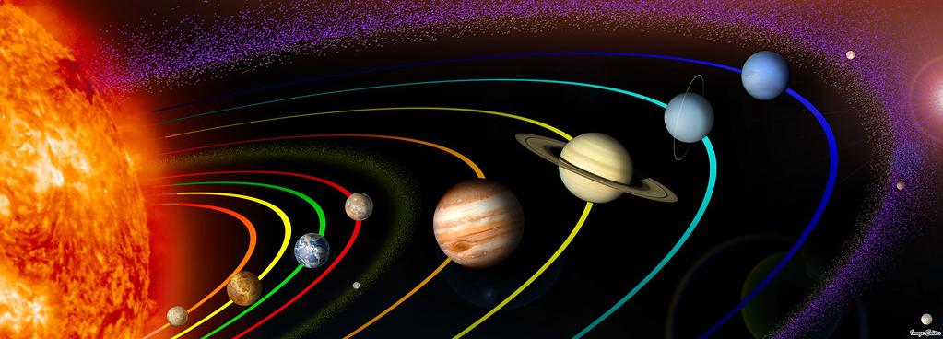
Who could create something like this?
What would happen if the Sun stopped working?
Or the trees stopped growing?
Or the planets just start falling out of the sky?
What is the hottest thing you have ever seen?
https://www.youtube.com/watch?v=Qd6nLM2QlWw&ebc
Notes:
Ask them what the hottest thing we have ever seen is!
Show them the ‘Exploring our solar system’ video (up to 2.30) and ask them to answer the question above.
Ask them if they know anyone who could create something like this? No one can ever create all these wonderful things like Allah can.
Discuss what would happen one day if the Sun stopped working or the trees stopped growing or the planets just start falling out of the sky!
Make sure you make a big deal of how amazing the Sun is that Allah created! The whole purpose of this part of the lesson is to make sure they understand that we need Allah at all times for things we don’t even realise.

Slide 9
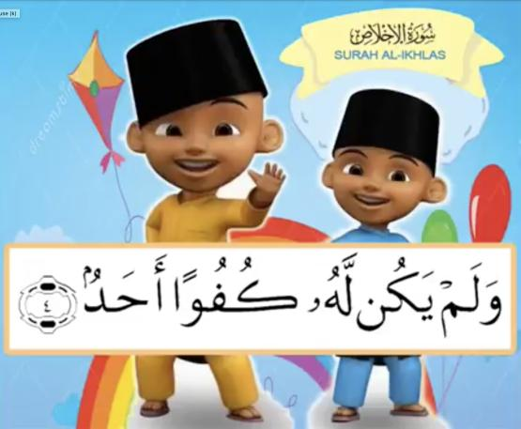
Can we name some of Allah’s amazing creations?
There is none like Him.
Notes:
Look at the final ayat. Ask them what they think this could mean?
Elicit the meaning. Have them name all the creations of Allah that amaze them.

Slide 10
Let’s review the meaning . . .
Say He Allah is One.
Allah does not need anyone.
He doesn’t have children,
He was not born.
There is none like Him.
Notes:
Listen to the poem and review the meaning of the whole surah again

Slide 11
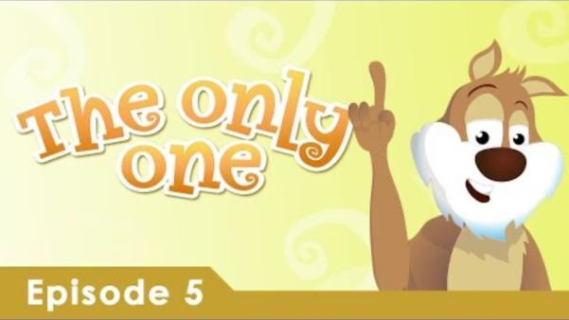
Allah does not need us, but we need Him!
Notes:
Optional (based on time)
Highlight how we need Allah and He does not need us.
Play the video from 2.25 – 8.50 minutes.

Slide 12
Lesson Summary
Recognize through Surat al-Ikhlas that there is only one God –Allah
1
Identify the problems associated with believing in more than ONE GOD
2
Conclude that Allah is needless but we need Him
3

